Slide 1
Prompt Perturbation and Robustness Evaluation
Shuyue Jia Ph.D. Student Boston University October 3rd, 2023
Notes:
Good afternoon, everyone.
Today, I gonna talk about the Prompt Perturbation and Robustness Evaluation of foundation models, or generally, machine learning models.
Currently, you know, it is a discussion-based meeting, so, If you have any questions, please feel free to ask me.

Slide 2
Outline
Prompt Perturbation and Robustness Evaluation
Probing vs. Prompting
Prompt Perturbation Category
Prompt Perturbation Selected Works
Robustness Problem Formulation
Robustness Evaluation
Notes:
There are six items on today’s agenda.
First, I’ll talk about the difference between probing and prompting. I want to highlight that probing is the process of exploring what knowledge is encoded in the large language models.
Then, I summarized and categorized prompt perturbation from the perspectives of granularities. In specific, modifying prompts via character-level, word-level, sentence-level, and adversary-level perturbations.
Next, two selected works of prompt perturbation will be shared with you.
Furthermore, I‘ll briefly present the definition, problem formulation, and evaluation of foundational robustness. I will present more in the future after I read more related papers.
Finally, I summarized previous weeks’ meetings, and I’ll also talk about my next week’s plan.

Slide 3
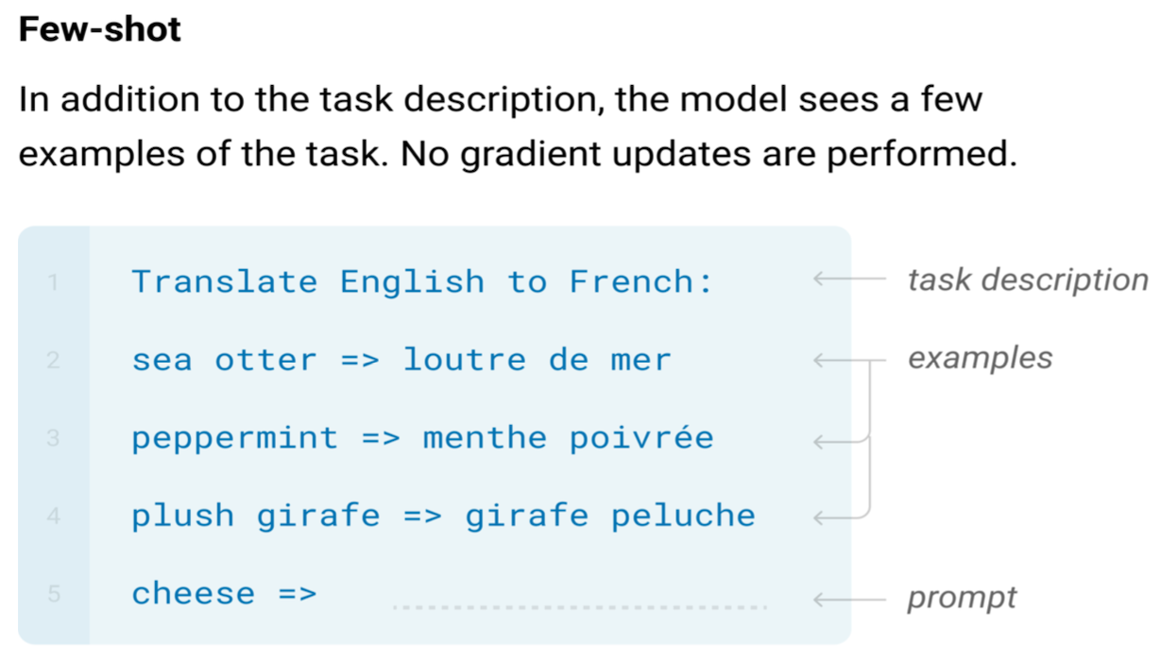
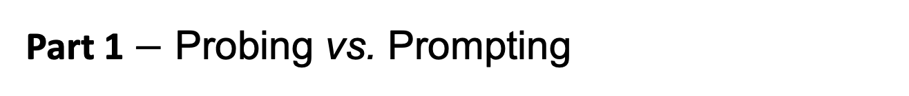
Part 1 $−$ Probing vs. Prompting
Prompt Perturbation and Robustness Evaluation
Prompting: use natural language to query the LLMs with descriptions, instructions, goals, and examples.
The way we access and interact with a language model.
instructions
examples
goals
Image Credits: In the public domain.
Notes:
The prompting is to use natural language to query the LLMs with descriptions, instructions, goals, and examples, as you can see from the example below, query the language model via instructions, examples, and goals. The prompting is the way we access and interact with a language model.

Slide 4
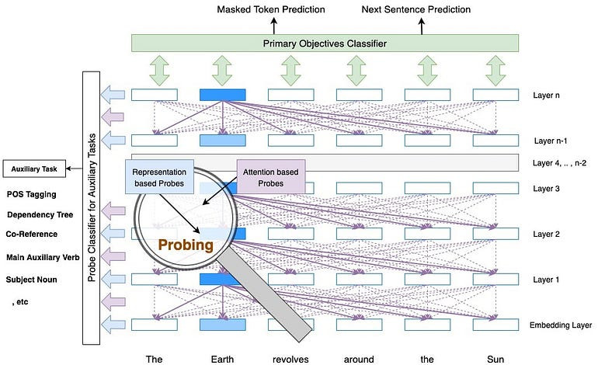
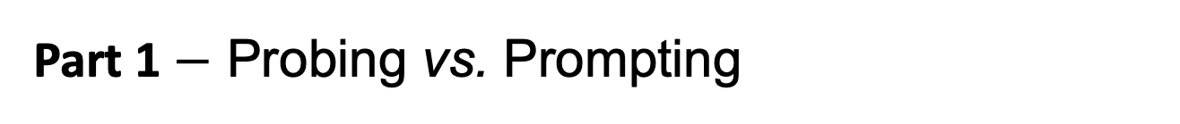
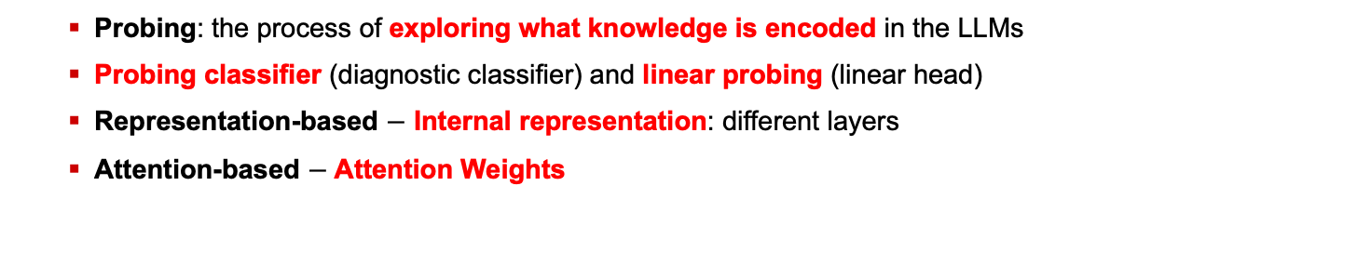
Part 1 $−$ Probing vs. Prompting
Prompt Perturbation and Robustness Evaluation
 | Probing | Fine-tuning | Multi-task Learning
Goal | Auxiliary Task | Primary Task | Primary Tasks
Update Model Parameters | No | Yes | Yes
Access Model Internals | Yes | No | No
Complexity | Shallow | Shallow or Deep | Shallow or Deep
Probing: the process of exploring what knowledge is encoded in the LLMs
Probing classifier (diagnostic classifier) and linear probing (linear head)
Representation-based $−$ Internal representation: different layers
Attention-based $−$ Attention Weights
Images Credits: Medium Post $−$ Linguistics Wisdom of NLP Models.
Notes:
Probing, on the other hand, is another way to access the model, specifically to explore what knowledge is encoded in the language model. As you can see from the left-hand image, we want to know what kinds of knowledge is learned or encoded in the layers or attention mechanisms. That’s why we need probing classifiers, as known as the diagnostic classifier.
Besides, another way to access the learned representations is to learn a linear head on top of a pre-trained language model. This linear head is also called linear probing. Generally, there are two kinds of probing stuff. One is to explore the learned knowledge in internal representations, for example, different layers, of the model. It is the representation-based method. The other is the knowledge inside the attention weights. It is the attention-based method.

Slide 5
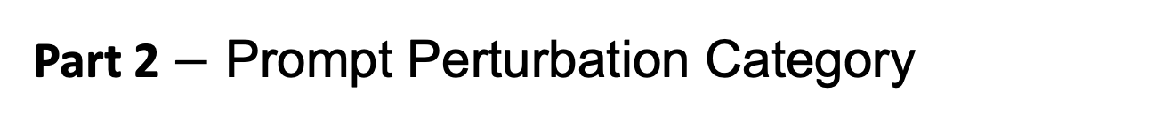
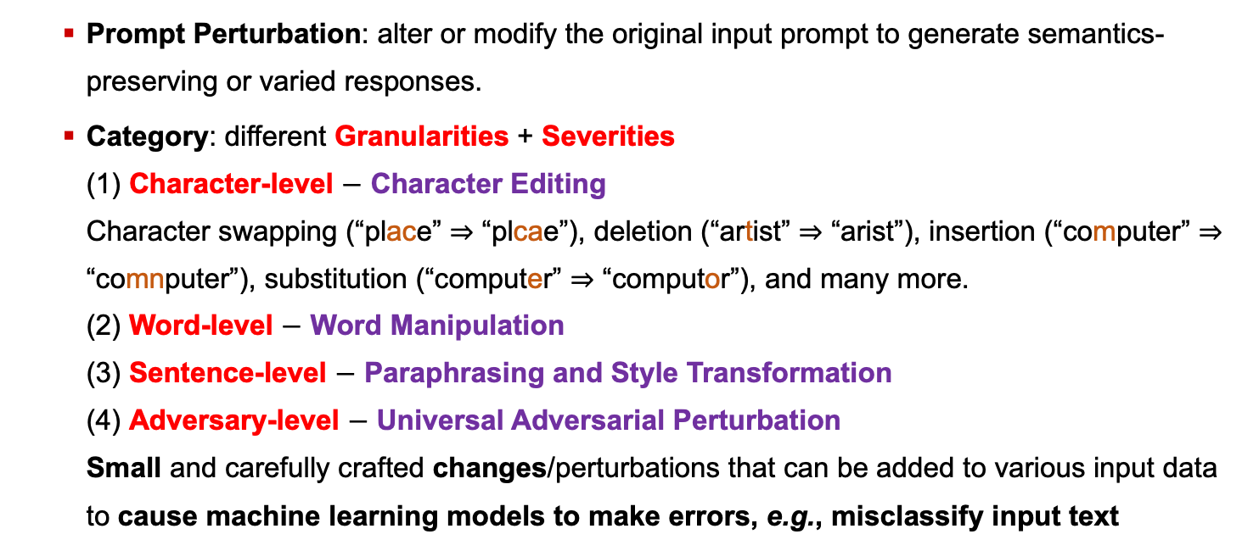
Part 2 $−$ Prompt Perturbation Category
Prompt Perturbation and Robustness Evaluation
Prompt Perturbation: alter or modify the original input prompt to generate semantics-preserving or varied responses.
Category: different Granularities + Severities (1) Character-level $−$ Character Editing Character swapping (“place” ⇒ “plcae”), deletion (“artist” ⇒ “arist”), insertion (“computer” ⇒ “comnputer”), substitution (“computer” ⇒ “computor”), and many more. (2) Word-level $−$ Word Manipulation (3) Sentence-level $−$ Paraphrasing and Style Transformation (4) Adversary-level $−$ Universal Adversarial Perturbation Small and carefully crafted changes/perturbations that can be added to various input data to cause machine learning models to make errors, e.g., misclassify input text
Credits: Li et al., A Survey on Out-of-Distribution Evaluation of Neural NLP Models, In arXiv’23.
Notes:
Here is our second part. Prompt Perturbation is to alter or modify the original input prompt to generate semantics-preserving or varied responses.
From the current literature, we can learn that prompt perturbation can be categorized by different granularities, such as character-level, you know, edit single or multiple characters, Word-level, you know, manipulate a word or words, Sentence-level, you know, paraphrase the sentence or transform the style of this sentence, and Adversary-level, you know, modify the prompt as adversarial examples.
Please note that the Universal Adversarial Perturbations (UAP) are small, carefully crafted perturbations that can be added to various input data to fool machine learning models consistently. These perturbations are typically imperceptible to humans but can cause the model to make incorrect predictions. Here are some examples:

Slide 6
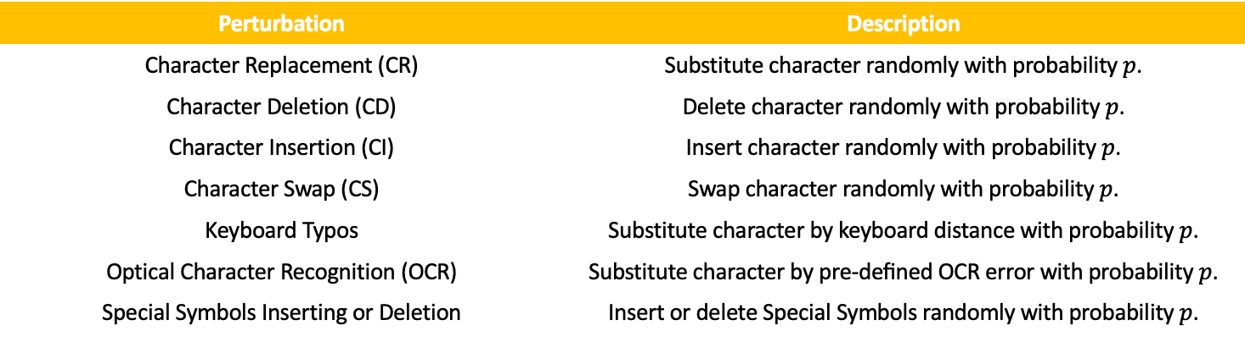
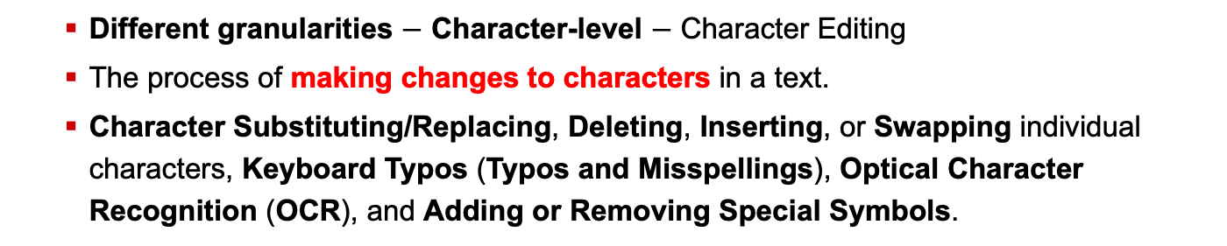
Part 2 $−$ Prompt Perturbation Category
Prompt Perturbation and Robustness Evaluation
Different granularities $−$ Character-level $−$ Character Editing
The process of making changes to characters in a text.
Character Substituting/Replacing, Deleting, Inserting, or Swapping individual characters, Keyboard Typos (Typos and Misspellings), Optical Character Recognition (OCR), and Adding or Removing Special Symbols.
Perturbation | Description
Character Replacement (CR) | Substitute character randomly with probability $p$.
Character Deletion (CD) | Delete character randomly with probability $p$.
Character Insertion (CI) | Insert character randomly with probability $p$.
Character Swap (CS) | Swap character randomly with probability $p$.
Keyboard Typos | Substitute character by keyboard distance with probability $p$.
Optical Character Recognition (OCR) | Substitute character by pre-deﬁned OCR error with probability $p$.
Special Symbols Inserting or Deletion | Insert or delete Special Symbols randomly with probability $p$.
Credits: Qiu et al., Are Multimodal Models Robust to Image and Text Perturbations?, In arXiv’23.
Notes:
As you can see here, there are several character-level prompt perturbation methods, namely, Character Replacement and substitution, Character Deletion, Character Insertion, Character Swap, Keyboard Typos, Optical Character Recognition, Special Symbols Inserting or Deletion, for example, the punctuations.

Slide 7
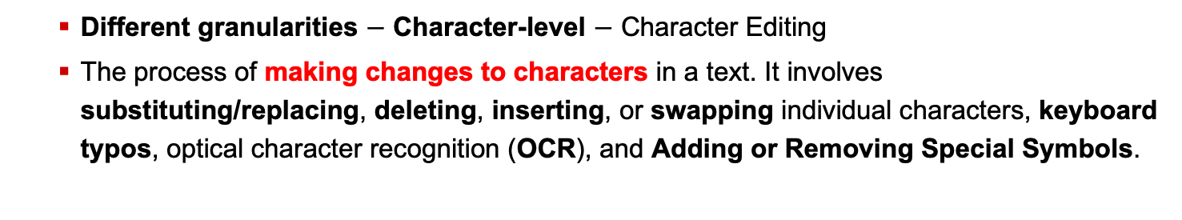
Part 2 $−$ Prompt Perturbation Category
Prompt Perturbation and Robustness Evaluation
Different granularities $−$ Character-level $−$ Character Editing
The process of making changes to characters in a text. It involves substituting/replacing, deleting, inserting, or swapping individual characters, keyboard typos, optical character recognition (OCR), and Adding or Removing Special Symbols.
Perturbation | Example
Clean | An orange metal bowl strainer ﬁlled with apples.
Character Replacement (CR) | An orange metal towl strainer ﬁllet with apples.
Character Deletion (CD) | An orang[X] metal bowl strainer ﬁl[X]ed with apples.
Character Insertion (CI) | And orange metal bowl strainer ﬁlled with atpples.
Character Swap (CS) | An orange meatl bowl stariner ﬁlled with apples.
Keyboard Typos | An orange metal bowk strainer ﬁlled witj apples.
Optical Character Recognition (OCR) | An 0range metal bowl strainer ﬁlled with app1es.
Special Symbols Inserting or Deletion | An orange metal bowl? strainer ﬁlled with apples!
Credits: Qiu et al., Are Multimodal Models Robust to Image and Text Perturbations?, In arXiv’23.
Notes:
Here are some examples of these cases for your reference.

Slide 8
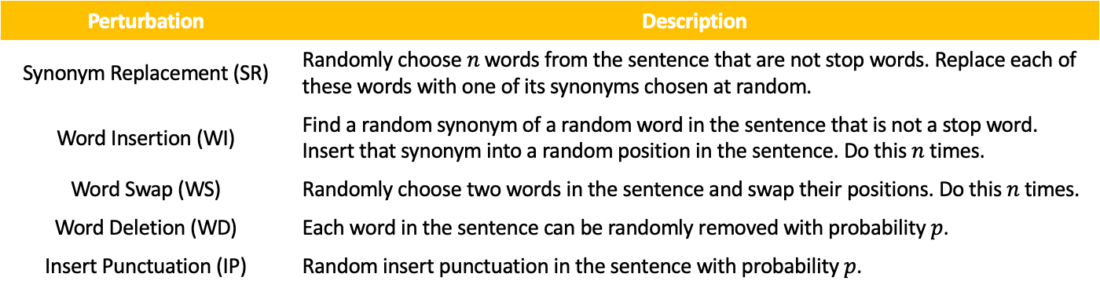
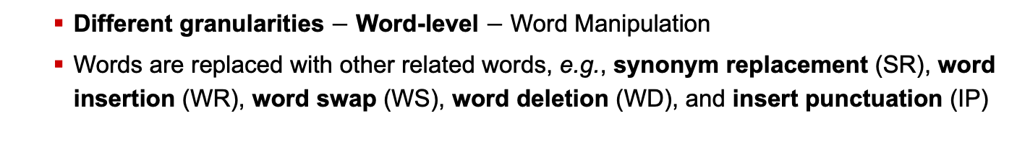
Part 2 $−$ Prompt Perturbation Category
Prompt Perturbation and Robustness Evaluation
Different granularities $−$ Word-level $−$ Word Manipulation
Words are replaced with other related words, e.g., synonym replacement (SR), word insertion (WR), word swap (WS), word deletion (WD), and insert punctuation (IP)
Perturbation | Description
Synonym Replacement (SR) | Randomly choose $n$ words from the sentence that are not stop words. Replace each of these words with one of its synonyms chosen at random.
Word Insertion (WI) | Find a random synonym of a random word in the sentence that is not a stop word. Insert that synonym into a random position in the sentence. Do this $n$ times.
Word Swap (WS) | Randomly choose two words in the sentence and swap their positions. Do this $n$ times.
Word Deletion (WD) | Each word in the sentence can be randomly removed with probability $p$.
Insert Punctuation (IP) | Random insert punctuation in the sentence with probability $p$.
Credits: Qiu et al., Are Multimodal Models Robust to Image and Text Perturbations?, In arXiv’23.
Notes:
As u can see here, there are several word manipulation methods, namely, Synonym Replacement, Word Insertion, Word Swap, Word Deletion, and Insert Punctuation.

Slide 9
Part 2 $−$ Prompt Perturbation Category
Prompt Perturbation and Robustness Evaluation
Different granularities $−$ Word-level $−$ Word Manipulation
Words are replaced with other related words, e.g., synonym replacement (SR), word insertion (WR), word swap (WS), word deletion (WD), and insert punctuation (IP)
Perturbation | Example
Clean | An orange metal bowl strainer ﬁlled with apples.
Synonym Replacement (SR) | An orange alloy bowl strainer ﬁlled with apples.
Word Insertion (WI) | An old orange metal bowl strainer ﬁlled with apples.
Word Swap (WS) | An orange metal strainer bowl ﬁlled with apples.
Word Deletion (WD) | An orange metal bowl strainer [X] with apples.
Insert Punctuation (IP) | An orange metal bowl ? strainer ﬁlled with apples.
Credits: Qiu et al., Are Multimodal Models Robust to Image and Text Perturbations?, In arXiv’23.
Notes:
Here are some examples of different word manipulation methods.

Slide 10
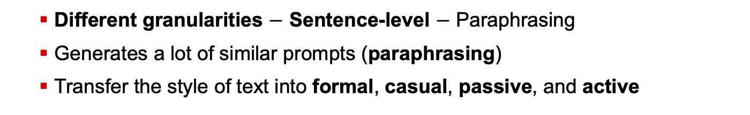
Part 2 $−$ Prompt Perturbation Category
Prompt Perturbation and Robustness Evaluation
Different granularities $−$ Sentence-level $−$ Paraphrasing
Generates a lot of similar prompts (paraphrasing)
Transfer the style of text into formal, casual, passive, and active
Perturbation | Description
Paraphrasing | Paraphrase the prompt, e.g., Back Translation: Translate the source to German and translate it back to English.
Formal Style | Transfer the text style to Formal.
Casual Style | Transfer the text style to Casual.
Passive Style | Transfer the text style to Passive.
Active Style | Transfer the text style to Active.
Credits: Qiu et al., Are Multimodal Models Robust to Image and Text Perturbations?, In arXiv’23.
Notes:
As you can see here, there are two main methods to perturb prompts at the sentence level. The first one is to paraphrase the prompt. People usually use back translation. For example, they would translate the prompt into German and then translate it back to English.
Another category is style transformation. As you can see, we can transfer the type into formal, casual, passive, and active. You know, you can even transfer the style into the Disney style.

Slide 11

Part 2 $−$ Prompt Perturbation Category
Prompt Perturbation and Robustness Evaluation
Different granularities $−$ Sentence-level $−$ Paraphrasing
Generates a lot of similar prompts (paraphrasing)
Transfer the style of text into formal, casual, passive, and active styles
Perturbation | Example
Clean | An orange metal bowl strainer ﬁlled with apples.
Paraphrasing | Apples are placed in an orange metal bowl strainer.
Formal Style | An orange metal bowl strainer contains apples.
Casual Style | An orange metal bowl is ﬁlled with apples.
Passive Style | Some apples are in an orange metal bowl strainer.
Active Style | There are apples in an orange metal bowl strainer.
Credits: Qiu et al., Are Multimodal Models Robust to Image and Text Perturbations?, In arXiv’23.
Notes:
Here are some examples of paraphrasing and style transformations.

Slide 12
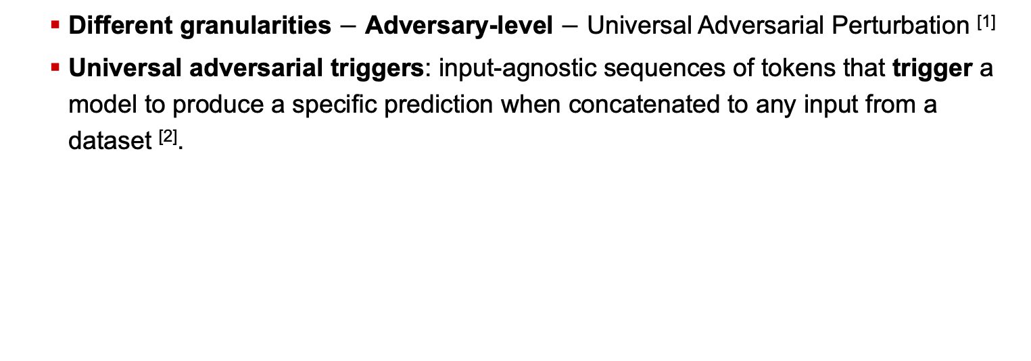
Part 2 $−$ Prompt Perturbation Category
Prompt Perturbation and Robustness Evaluation
Different granularities $−$ Adversary-level $−$ Universal Adversarial Perturbation ^{[1]}
Universal adversarial triggers: input-agnostic sequences of tokens that trigger a model to produce a speciﬁc prediction when concatenated to any input from a dataset ^{[2]}.
Input (red = trigger) | Model Prediction
zoning tapping ﬁennes Visually imaginative, thematically instructive and thoroughly delightful, it takes us on a roller-coaster ride. . . | Positive → Negative
zoning tapping ﬁennes As surreal as a dream and as detailed as a photograph, as visually dexterous as it is at times imaginatively overwhelming. | Positive → Negative
Credits:
[1] Moosavi-Dezfooli et al., Universal Adversarial Perturbations, In CVPR’17.
[2] Wallace et al., Universal Adversarial Triggers for Attacking and Analyzing NLP, In arXiv’23.
Notes:
The last category is the adversary-level prompt perturbation. For example, add a Universal adversarial trigger to someplace in the prompt.
Please note that the universal adversarial triggers are the input-agnostic sequences of tokens that trigger a model to produce a speciﬁc prediction when concatenated to any input from a dataset.

Slide 13
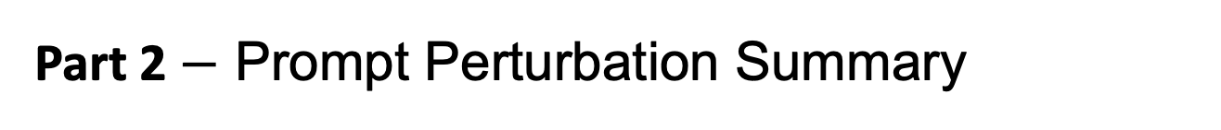
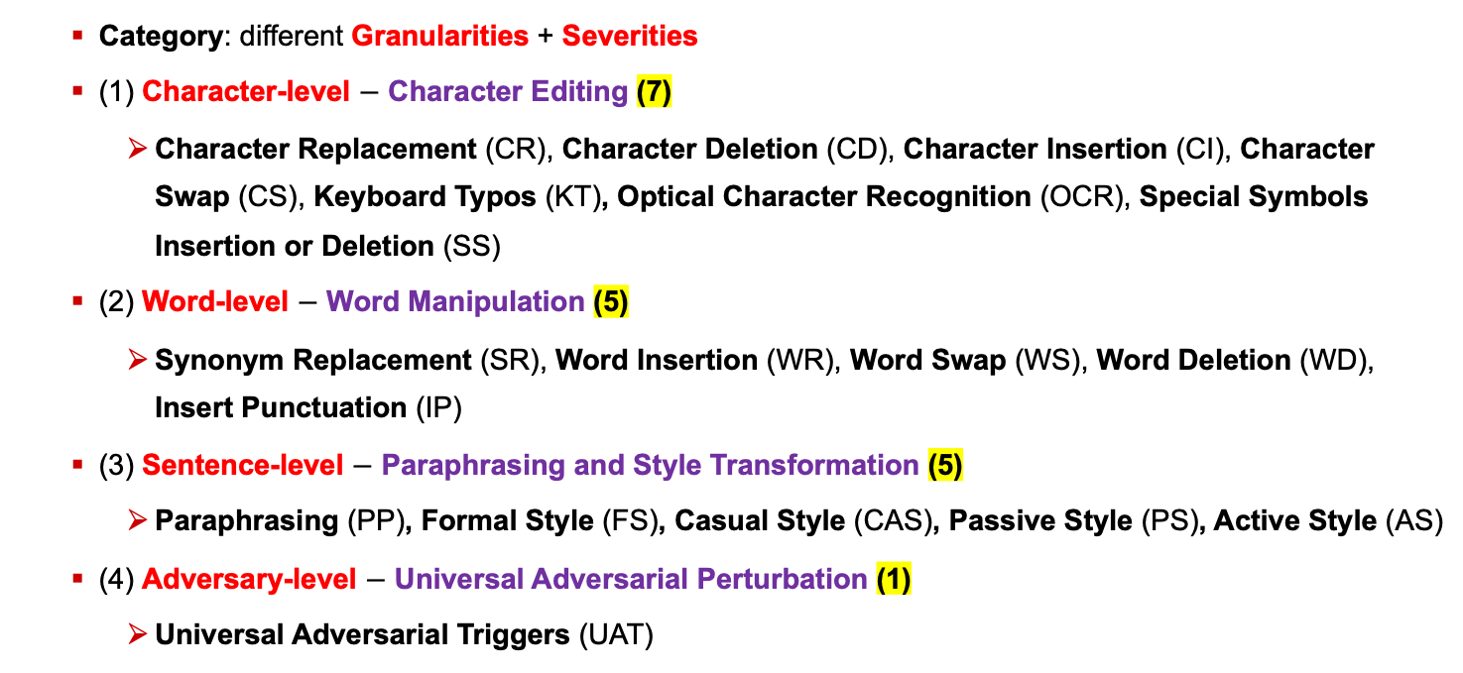
Part 2 $−$ Prompt Perturbation Summary
Prompt Perturbation and Robustness Evaluation
Category: different Granularities + Severities
(1) Character-level $−$ Character Editing (7)
Character Replacement (CR), Character Deletion (CD), Character Insertion (CI), Character Swap (CS), Keyboard Typos (KT), Optical Character Recognition (OCR), Special Symbols Insertion or Deletion (SS)
(2) Word-level $−$ Word Manipulation (5)
Synonym Replacement (SR), Word Insertion (WR), Word Swap (WS), Word Deletion (WD), Insert Punctuation (IP)
(3) Sentence-level $−$ Paraphrasing and Style Transformation (5)
Paraphrasing (PP), Formal Style (FS), Casual Style (CAS), Passive Style (PS), Active Style (AS)
(4) Adversary-level $−$ Universal Adversarial Perturbation (1)
Universal Adversarial Triggers (UAT)
Notes:
Here is a summary of the prompt perturbations from four perspectives. As for the severities, in the multimodal paper they applied 5 different levels of severity for character and word perturbations, and one level for sentence perturbation.

Slide 14
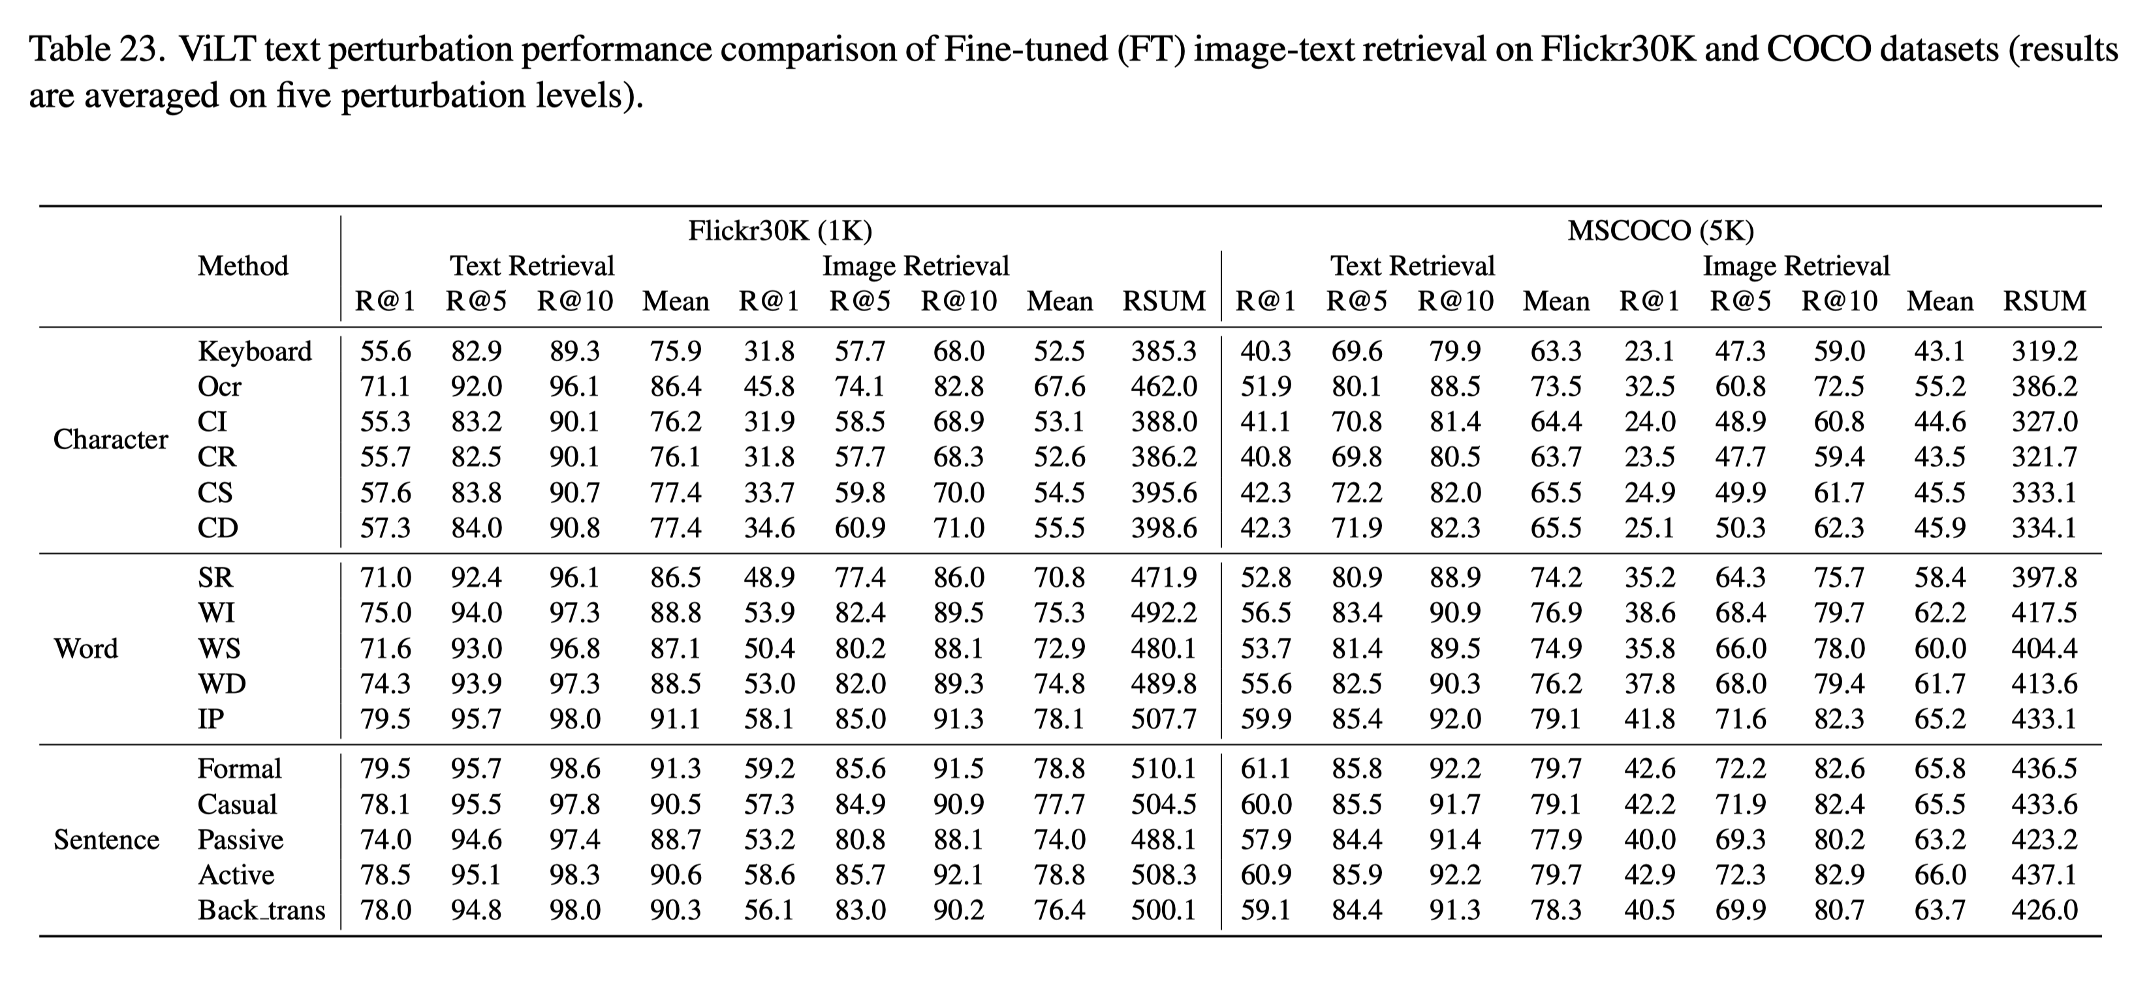
Part 2 $−$ Prompt Perturbation Summary
Prompt Perturbation and Robustness Evaluation
Recall@K: how many relevant items were returned in the first K items against how many relevant items exist in the entire dataset (TP+FN); RSUM: the sum of recall R@K metric
Flickr30K/COCO dataset: 1,000/5,000 images, each with 5 corresponding captions
Credits: Qiu et al., Are Multimodal Models Robust to Image and Text Perturbations?, In arXiv’23.

Slide 15
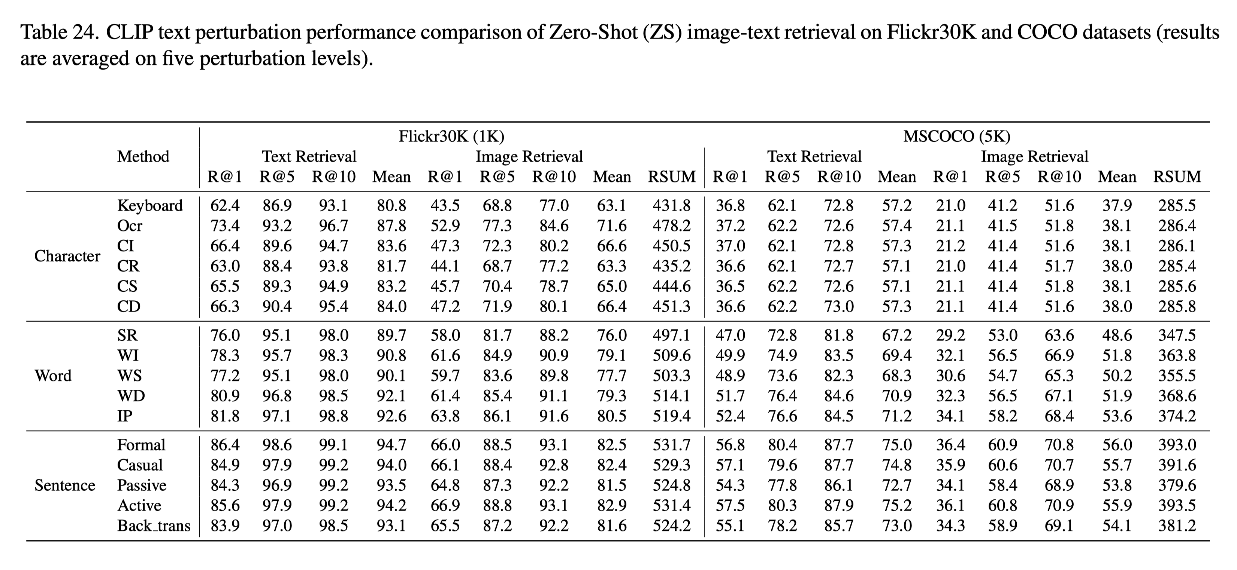
Part 2 $−$ Prompt Perturbation Summary
Prompt Perturbation and Robustness Evaluation
Credits: Qiu et al., Are Multimodal Models Robust to Image and Text Perturbations?, In arXiv’23.

Slide 16
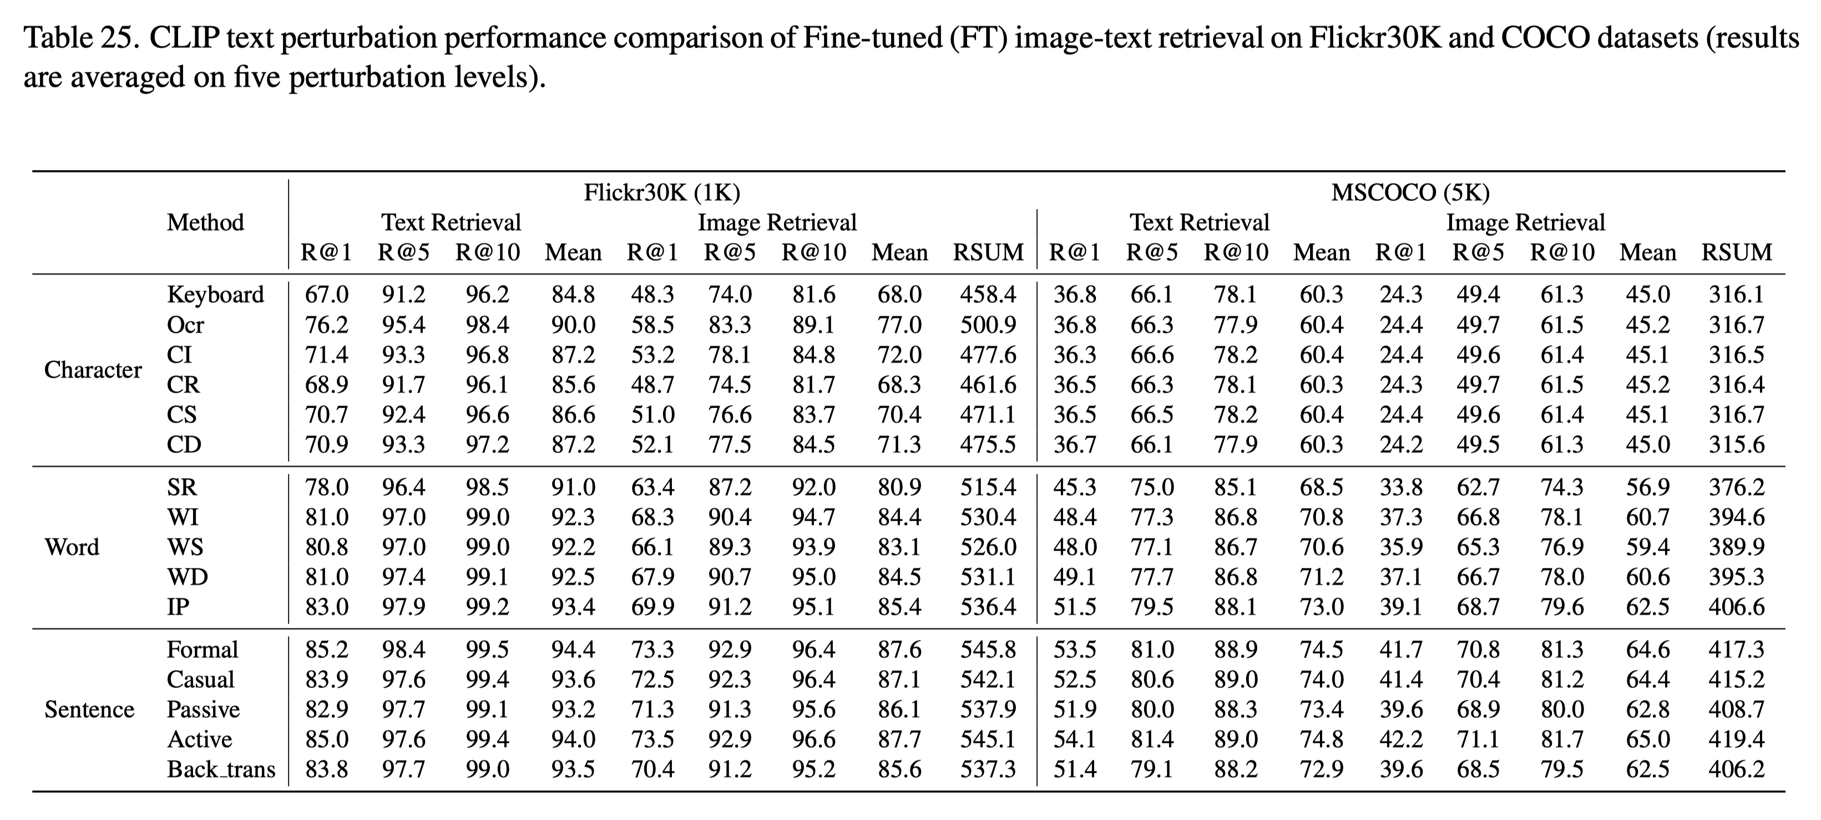
Part 2 $−$ Prompt Perturbation Summary
Prompt Perturbation and Robustness Evaluation
Credits: Qiu et al., Are Multimodal Models Robust to Image and Text Perturbations?, In arXiv’23.

Slide 17
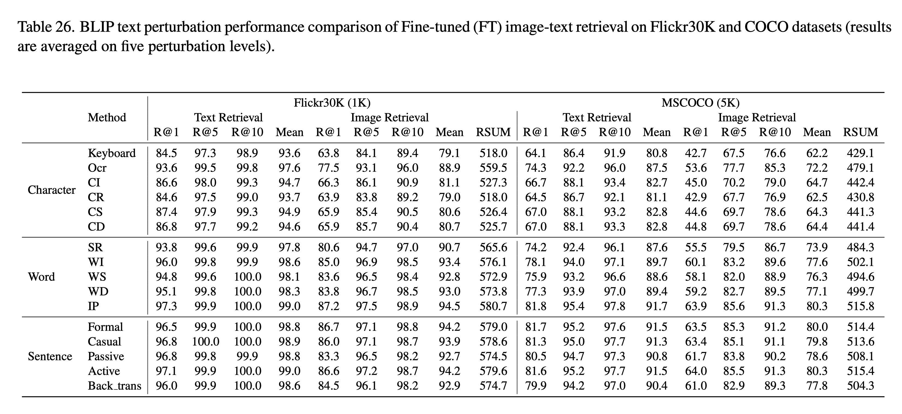
Part 2 $−$ Prompt Perturbation Summary
Prompt Perturbation and Robustness Evaluation
Credits: Qiu et al., Are Multimodal Models Robust to Image and Text Perturbations?, In arXiv’23.

Slide 18
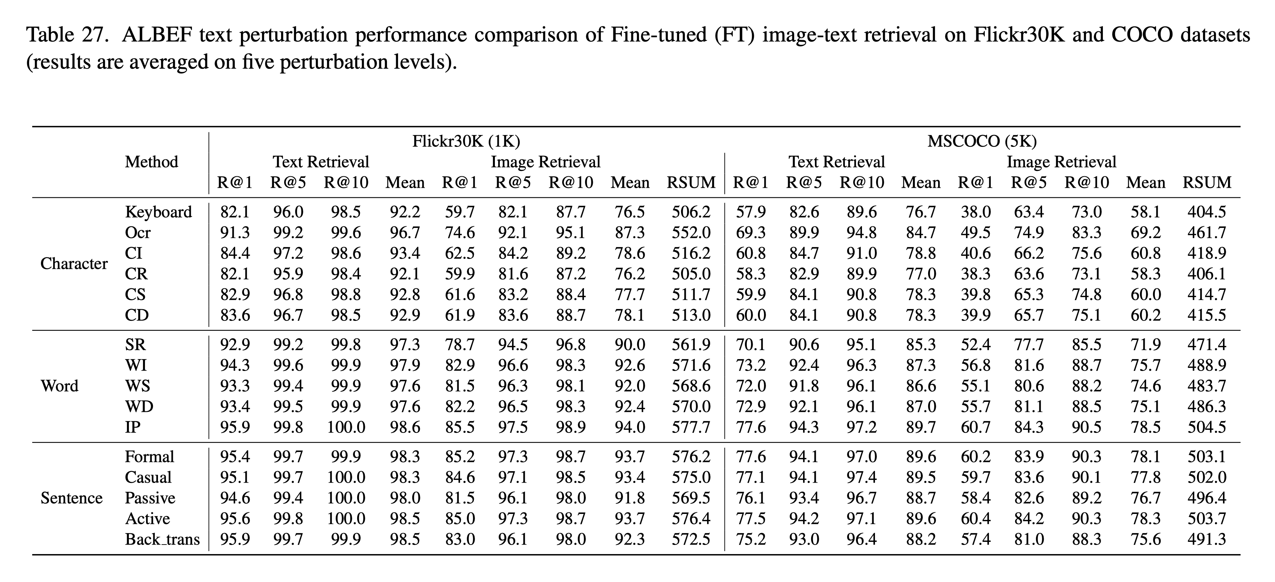
Part 2 $−$ Prompt Perturbation Summary
Prompt Perturbation and Robustness Evaluation
Credits: Qiu et al., Are Multimodal Models Robust to Image and Text Perturbations?, In arXiv’23.

Slide 19
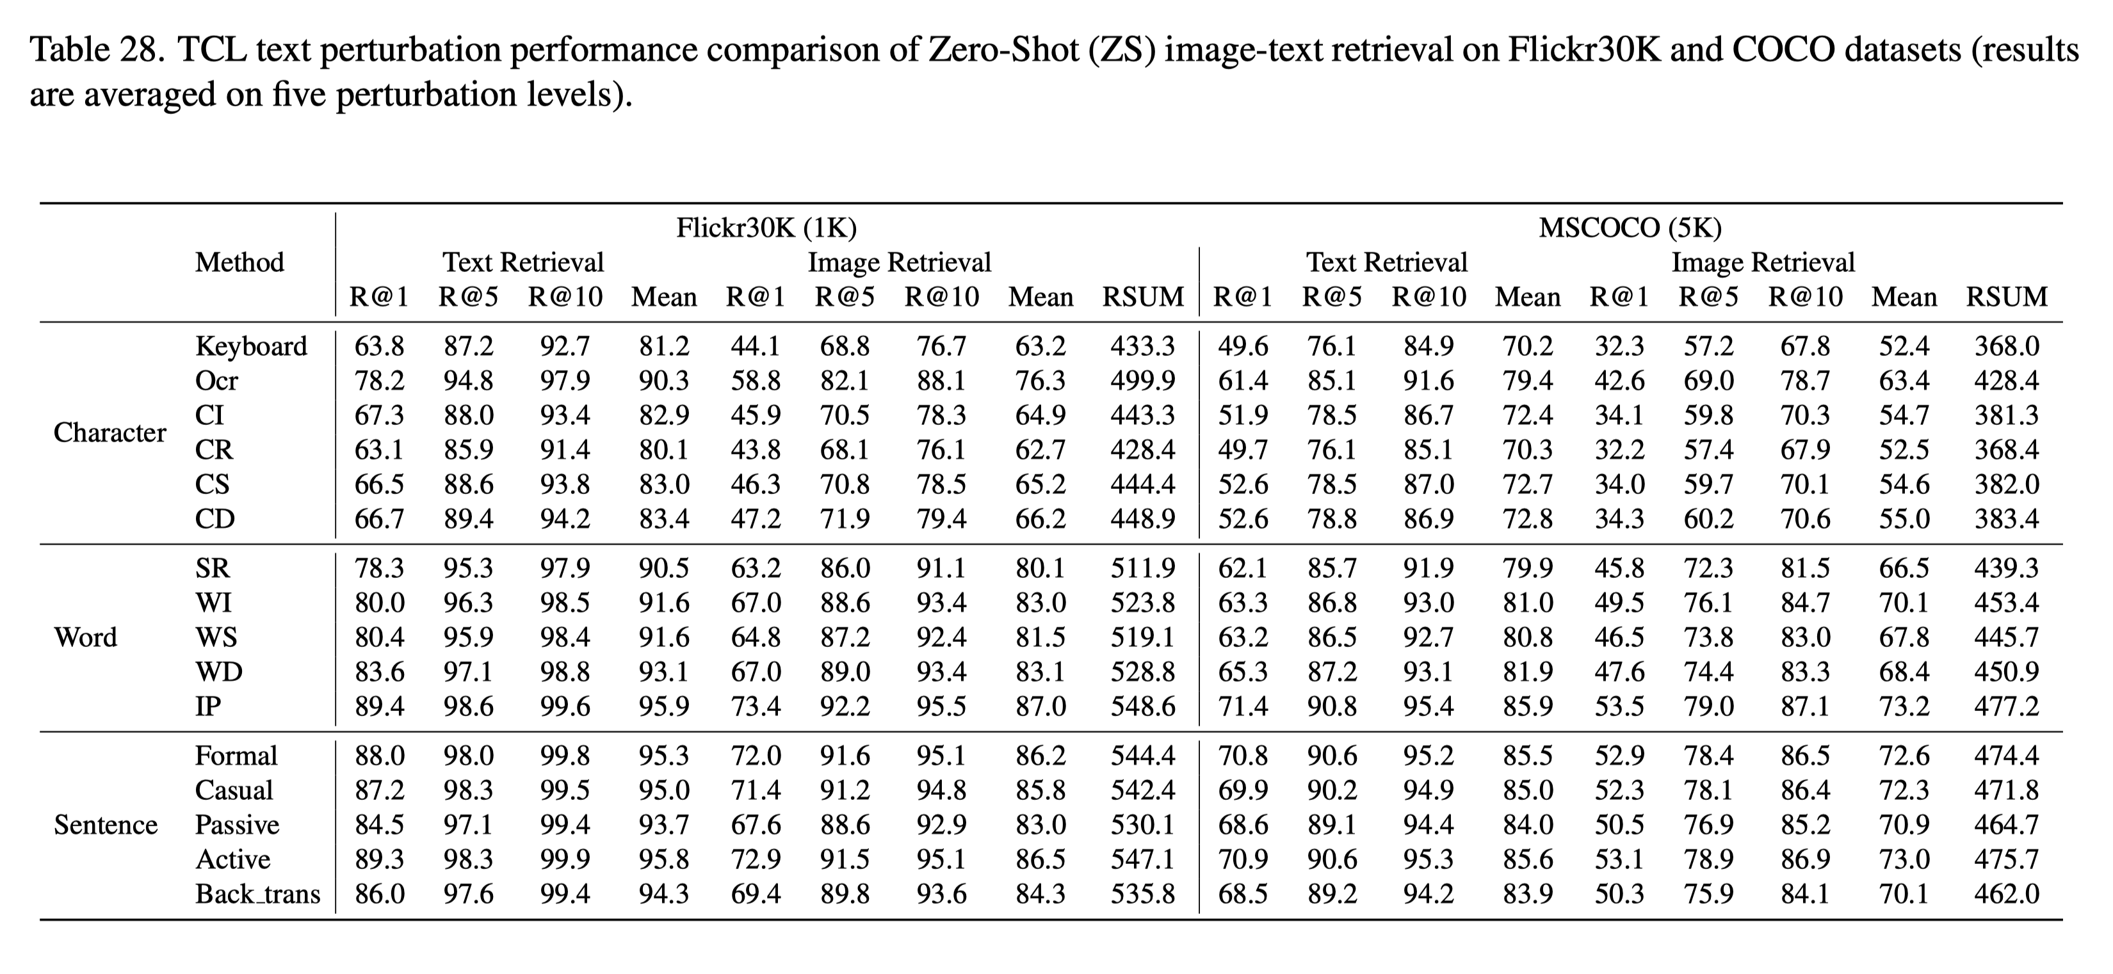
Part 2 $−$ Prompt Perturbation Summary
Prompt Perturbation and Robustness Evaluation
Credits: Qiu et al., Are Multimodal Models Robust to Image and Text Perturbations?, In arXiv’23.

Slide 20
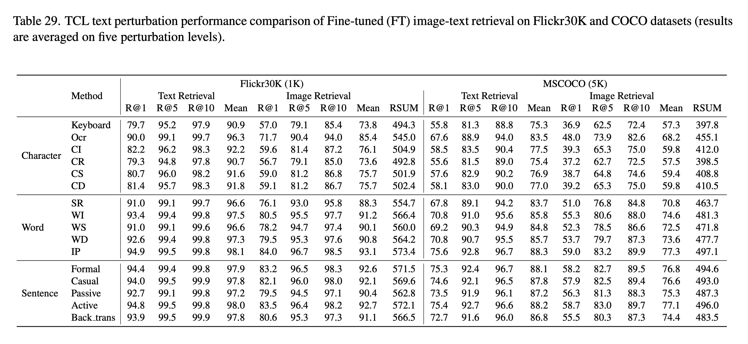
Part 2 $−$ Prompt Perturbation Summary
Prompt Perturbation and Robustness Evaluation
Credits: Qiu et al., Are Multimodal Models Robust to Image and Text Perturbations?, In arXiv’23.

Slide 21
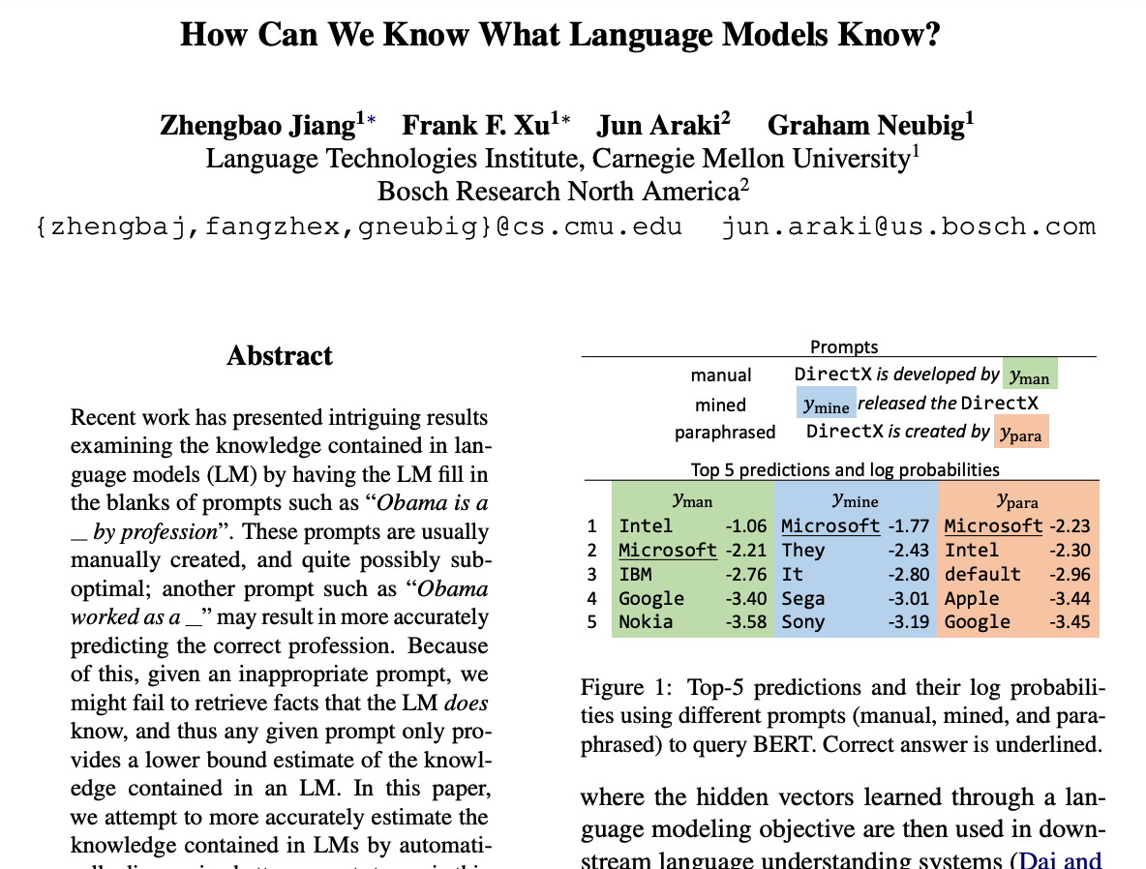
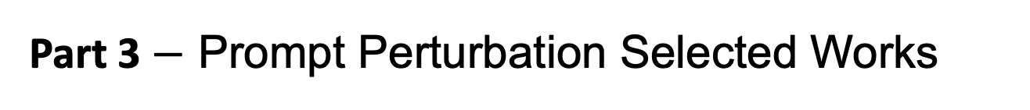
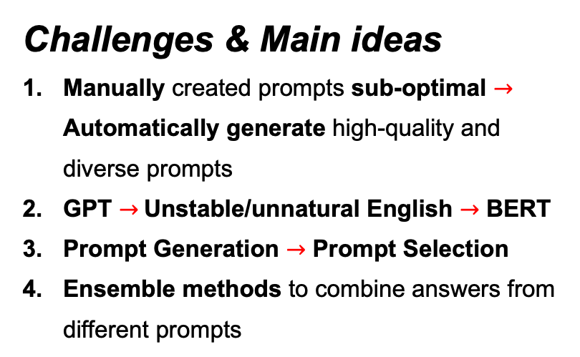
Part 3 $−$ Prompt Perturbation Selected Works
Prompt Perturbation and Robustness Evaluation
Related Work 1: Zhengbao Jiang, Frank F. Xu, Jun Araki, and Graham Neubig. How Can We Know What Language Models Know?, Transactions of the Association for Computational Linguistics, 8:423–438, 2020.
Challenges & Main ideas
Manually created prompts sub-optimal $→$ Automatically generate high-quality and diverse prompts
GPT $→$Unstable/unnatural English $→$ BERT
Prompt Generation $→$ Prompt Selection
Ensemble methods to combine answers from different prompts
Notes:
In the next part, I will present two prompt perturbation works. The first is the Mining and paraphrasing-based work. As you can see here, the challenges and main ideas are:
First, since the manually created prompts are usually sub-optimal, they want to automatically generate high-quality and diverse prompts. I also think that automatic prompt generation and prompt optimization are critical for us to get better answers from large language models.
Second, during their initial experiments, they found that the results based on autoregressive language models were not satisfied. So, they use BERT model instead.
Third, in this field, the general framework is Prompt Generation first and then Prompt Selection.
The last one is to use ensemble methods to combine answers from different prompts.

Slide 22
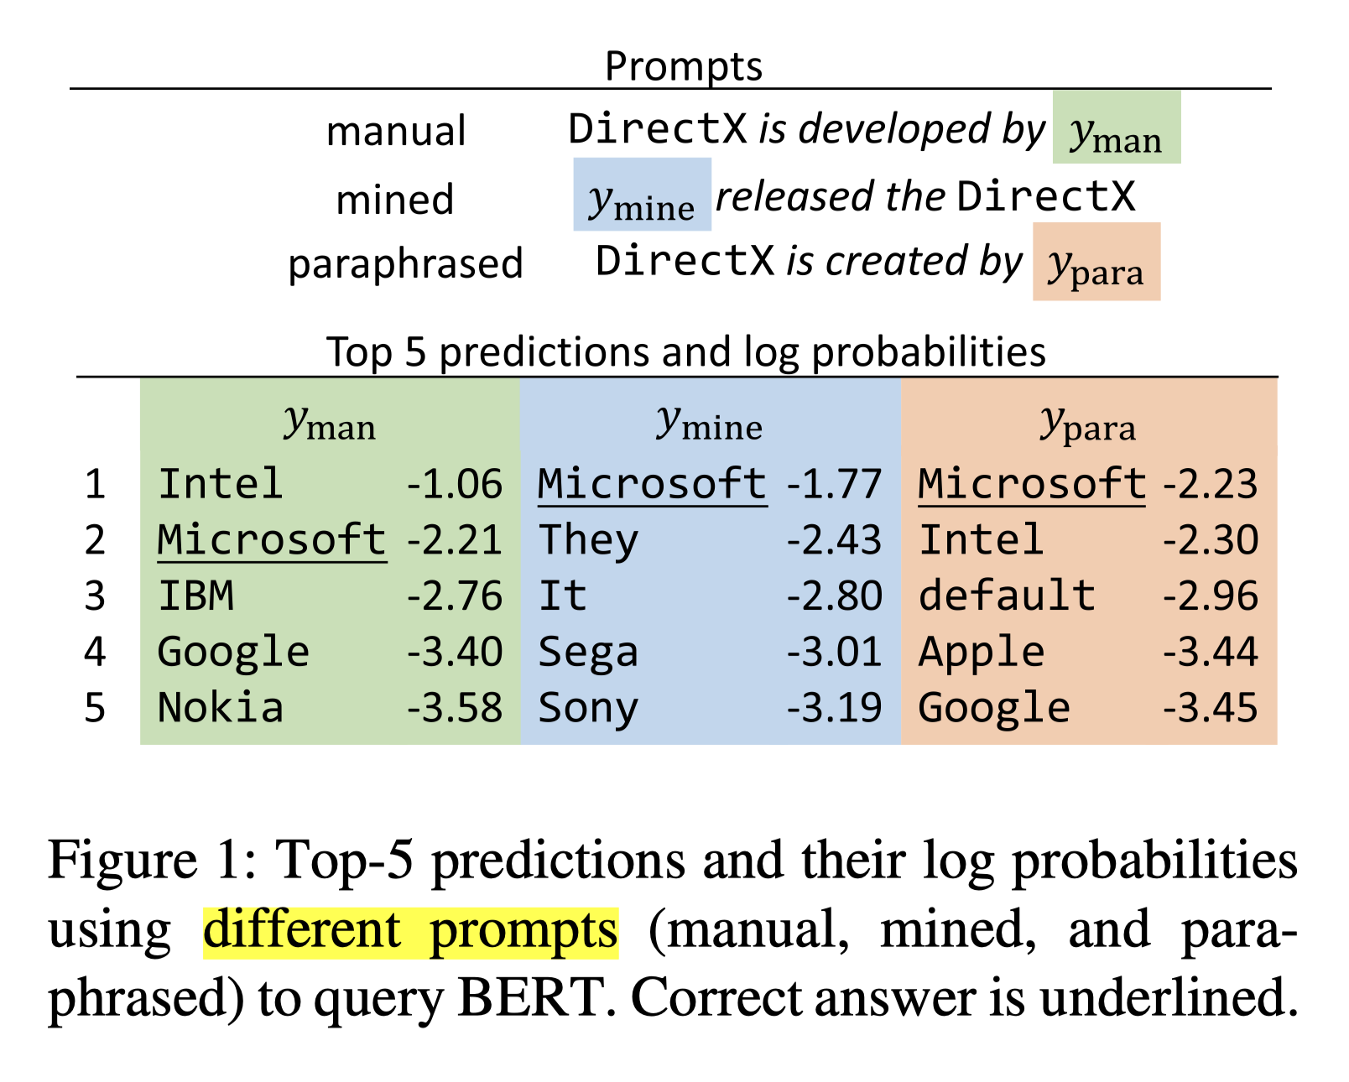
Part 3 $−$ Prompt Perturbation Selected Works
Prompt Perturbation and Robustness Evaluation
Objectives
Prompt Generation - Mining-based Generation - Paraphrasing-based Generation
Prompt Selection - Top-1 Prompt Selection
Prompt Ensembling - Rank-based Ensemble - Optimized Ensemble
Credits: Jiang et al., How Can We Know What Language Models Know?, In TACL’20.
Notes:
As you can see here, the objectives are:

Slide 23
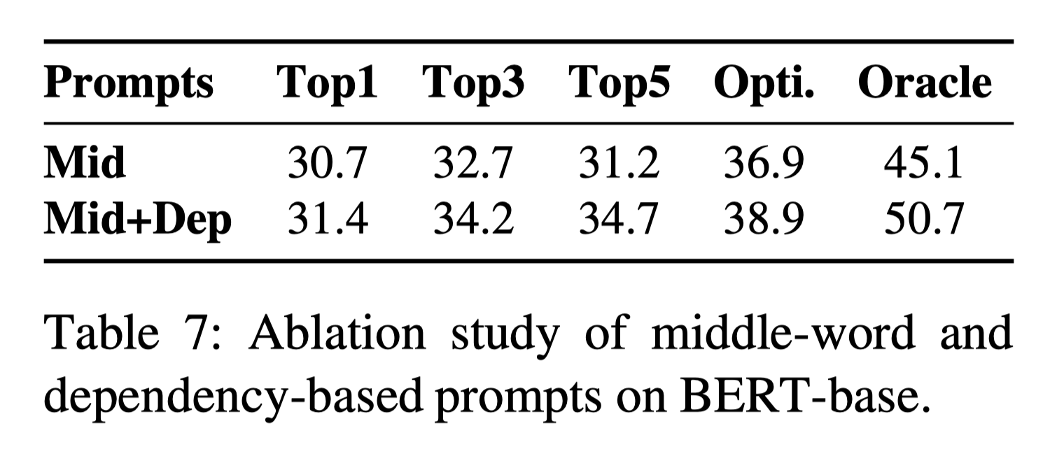
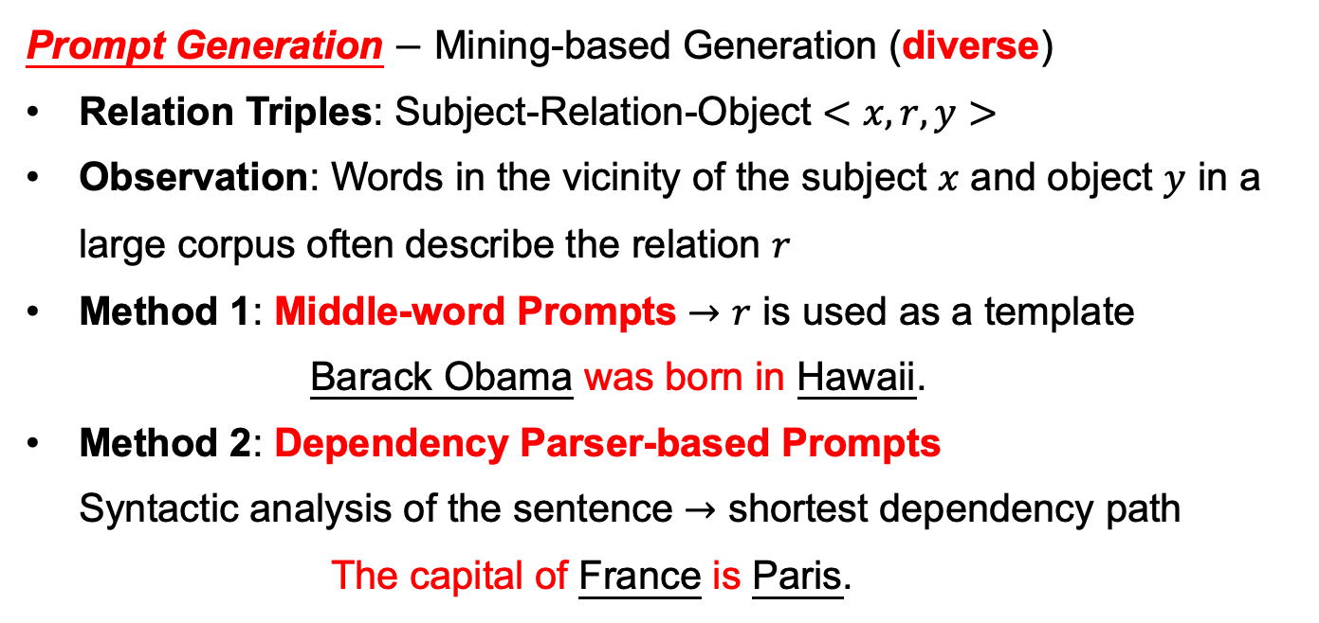
Part 3 $−$ Prompt Perturbation Selected Works
Prompt Perturbation and Robustness Evaluation
Prompt Generation $−$ Mining-based Generation (diverse)
Relation Triples: Subject-Relation-Object $<x,r,y>$
Observation: Words in the vicinity of the subject $x$ and object $y$ in a large corpus often describe the relation $r$
Method 1: Middle-word Prompts $→$ $r$ is used as a template Barack Obama was born in Hawaii.
Method 2: Dependency Parser-based Prompts Syntactic analysis of the sentence $→$ shortest dependency path The capital of France is Paris.
Credits: Jiang et al., How Can We Know What Language Models Know?, In TACL’20.
Notes:
First, one of the ideas of this work is the Mining-based Generation. In this way, the mined prompts are diverse. Here, please note that they specifically focus on relation triples, Subject-Relation-Object. The observation is that Words in the vicinity of the subject 𝑥 and object 𝑦 in a large corpus often describe the relation 𝑟. So, they applied two Mining-based methods. The first one is the Middle-word Prompts, the middle relation will be the prompt. Another method is the Dependency Parser-based Prompts, they employed a Dependency Parser to analyze the syntactics of the sentence. They used the shortest dependency path as the prompt.

Slide 24
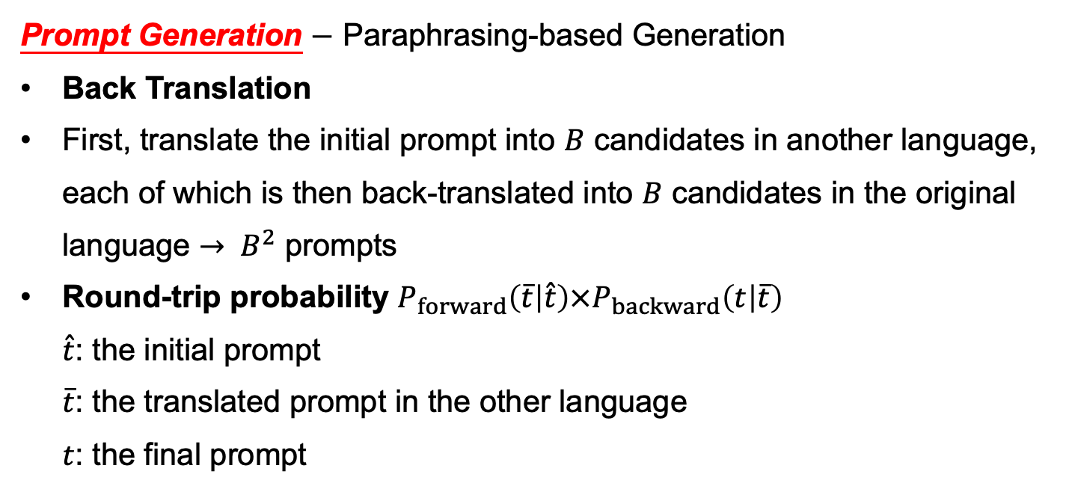
Part 3 $−$ Prompt Perturbation Selected Works
Prompt Perturbation and Robustness Evaluation
Prompt Generation $−$ Paraphrasing-based Generation
Back Translation
First, translate the initial prompt into $B$ candidates in another language, each of which is then back-translated into $B$ candidates in the original language $→ B^{2}$ prompts
Round-trip probability $P_{forward}\left(\overline{t} | \hat{t}\right)×P_{backward}\left(t | \overline{t}\right)$ $\hat{t}$: the initial prompt $\overline{t}$: the translated prompt in the other language $t$: the final prompt
Credits: Jiang et al., How Can We Know What Language Models Know?, In TACL’20.
Notes:
Another prompt generation method is the paraphrasing-based generation. They applied Back Translation: First, translate the initial prompt into $B$ candidates in another language, each of which is then back-translated into $B$ candidates in the original language. In this way, they will get $B^{2}$ prompts.
All the paraphrasing prompts will be ranked via the round-trip probability.

Slide 25
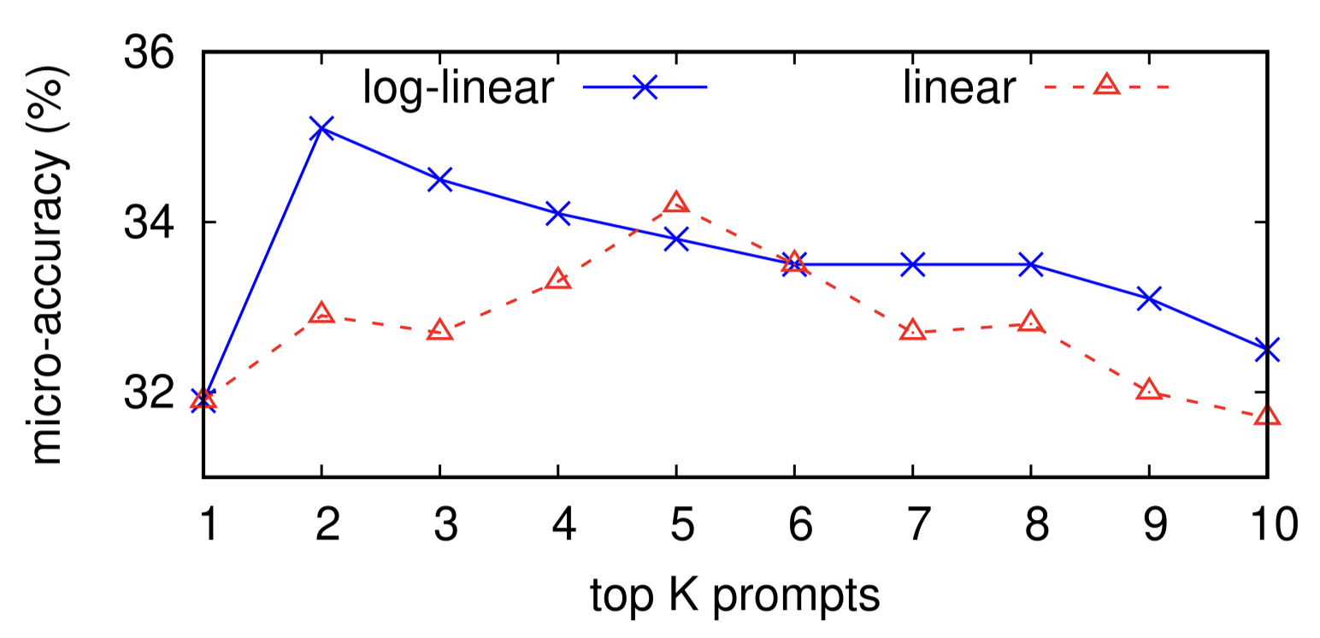
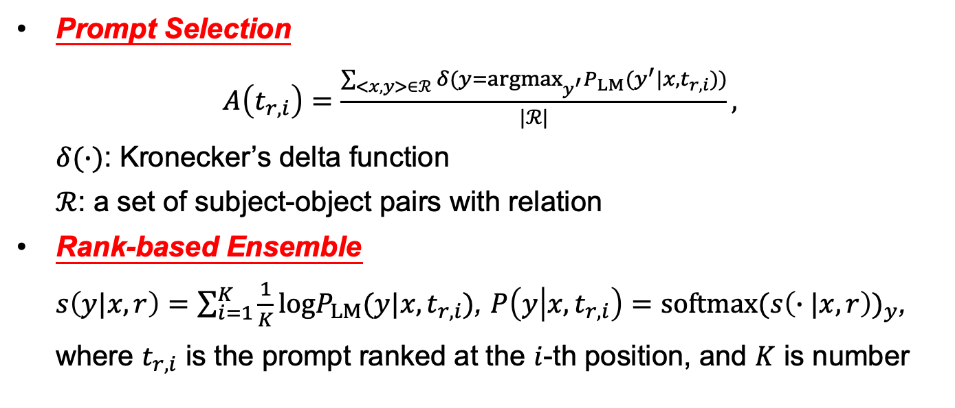
Part 3 $−$ Prompt Perturbation Selected Works
Prompt Perturbation and Robustness Evaluation
Prompt Selection $A\left(t_{r,i}\right)=\frac{\sum_{<x,y>∈ℛ}{δ(y={argmax}_{y^{′}}P_{LM}(y^{′}|x,t_{r,i}))}}{|ℛ|},$ $δ(∙)$: Kronecker’s delta function $ℛ$: a set of subject-object pairs with relation
Rank-based Ensemble $s\left(y|x,r\right)=\sum_{i=1}^{K}{\frac{1}{K}logP_{LM}(y|x,t_{r,i})}$, $P\left(y | x,t_{r,i}\right)=softmax{(s\left(∙|x,r\right))}_{y}$, where $t_{r,i}$ is the prompt ranked at the $i$-th position, and $K$ is number
Credits: Jiang et al., How Can We Know What Language Models Know?, In TACL’20.
Notes:
After the prompt generation, they will select the top-1 prompt or multiple prompts. The easy way is to measure the accuracy of predicting the ground-truth objects on the training dataset. And they will choose the prompt with the highest accuracy and query using only this prompt.
What’s more, it would be better to select multiple prompts because the LM may have observed different entity pairs in different contexts within its training data, and having a variety of prompts may allow for the elicitation of knowledge that appeared in these different contexts. Here, they applied the average log probabilities from the top K prompts to calculate the probability of the object. The reason why they use the log probability instead of the original probability is that the log probabilities make it possible to penalize objects that are very unlikely given any certain prompt. Meanwhile, as you can see from the right-hand image, the performance is superior when they apply the log probability.

Slide 26
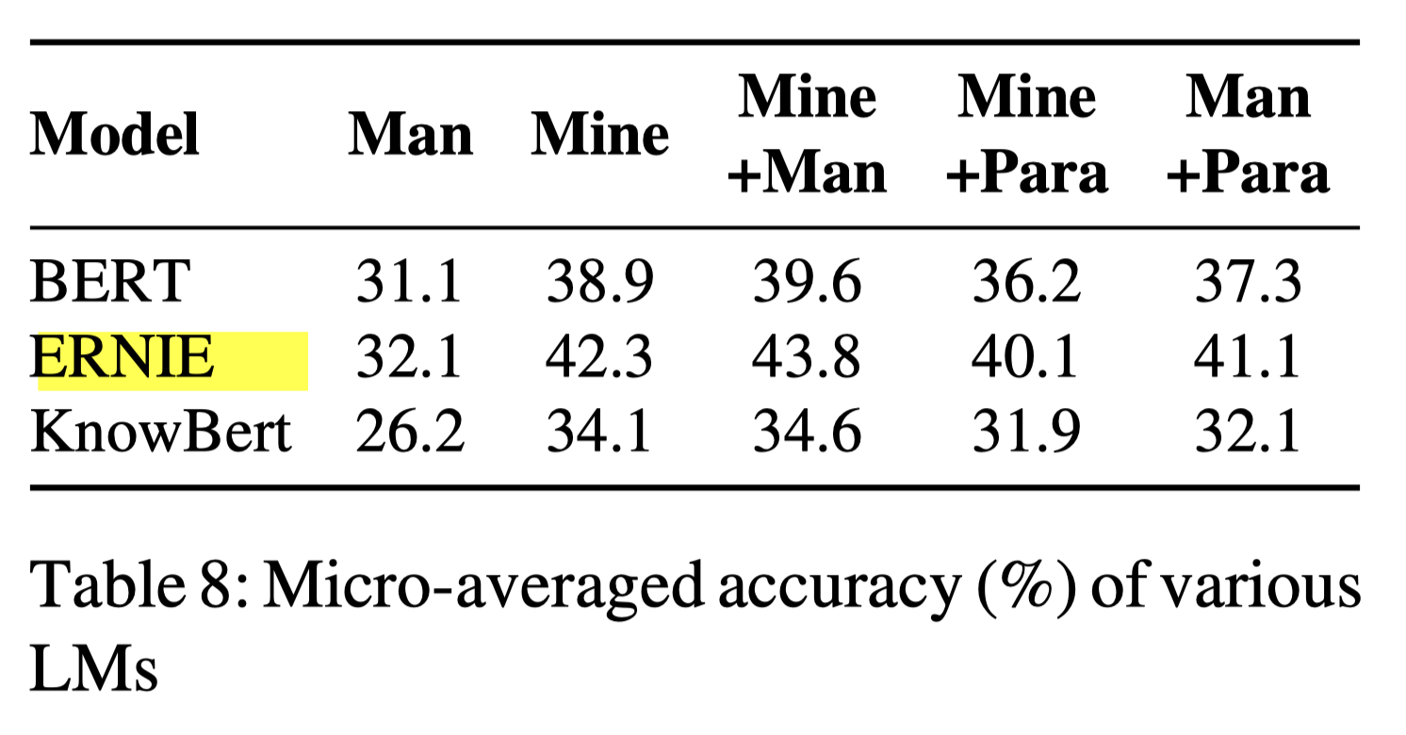
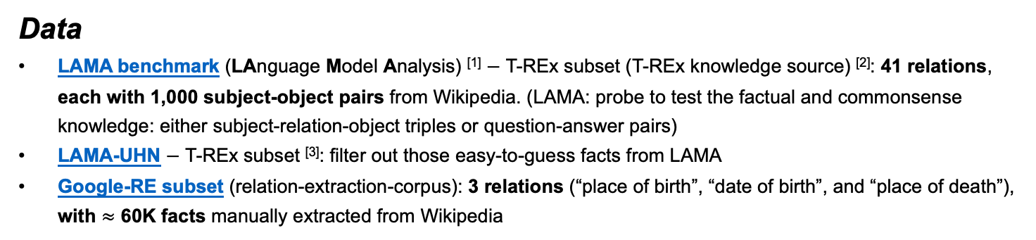
Part 3 $−$ Prompt Perturbation Selected Works
Prompt Perturbation and Robustness Evaluation
Data
LAMA benchmark (LAnguage Model Analysis) ^{[1]} $−$ T-REx subset (T-REx knowledge source) ^{[2]}: 41 relations, each with 1,000 subject-object pairs from Wikipedia. (LAMA: probe to test the factual and commonsense knowledge: either subject-relation-object triples or question-answer pairs)
LAMA-UHN $−$ T-REx subset ^{[3]}: filter out those easy-to-guess facts from LAMA
Google-RE subset (relation-extraction-corpus): 3 relations (“place of birth”, “date of birth”, and “place of death”), with $≈$ 60K facts manually extracted from Wikipedia
Models
BERT-base and BERT-large models ^{[4]}
^{[5]}
Credits:
[1] Petroni et al., Language Models as Knowledge Bases?, In EMNLP’19.
[2] ElSahar et al., T-REx: A Large Scale Alignment of Natural Language with Knowledge Base Triples, In LREC’18.
[3] Porner et al., BERT is Not a Knowledge Base (Yet): Factual Knowledge vs. Name-based Reasoning in Unsupervised QA, In arXiv’20.
[4] Devlin et al., BERT: Pre-training of Deep Bidirectional Transformers for Language Understanding, In NAACL’19.
[5] Zhang et al., ERNIE: Enhanced Language Representation with Informative Entities, In ACL’19.
Notes:
In this work, they applied their method to three benchmark databases, and two models, the BERT base and large models. They compared the performance of their method with ERNIE and KnowBert models.

Slide 27
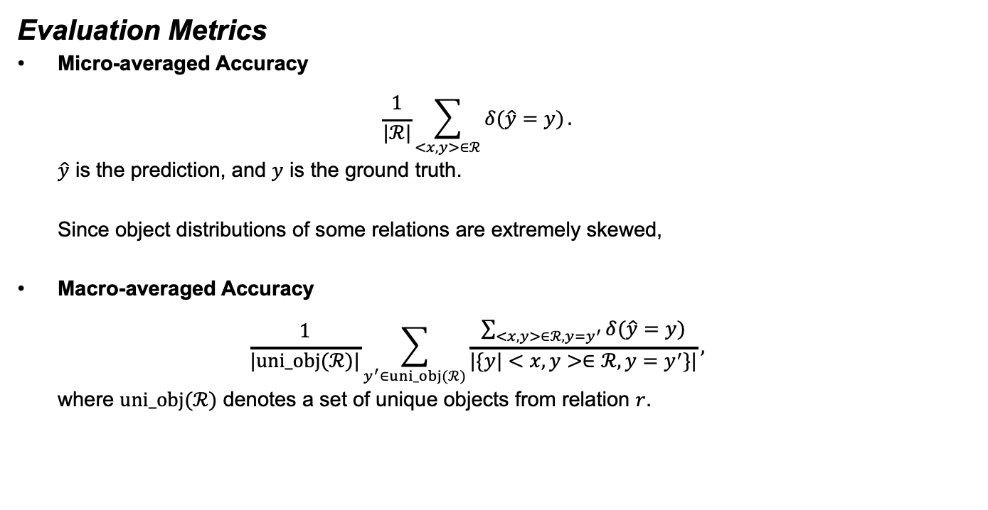
Part 3 $−$ Prompt Perturbation Selected Works
Prompt Perturbation and Robustness Evaluation
Evaluation Metrics
Micro-averaged Accuracy $\frac{1}{|ℛ|}\sum_{<x,y>∈ℛ}{δ(\hat{y}=y)}.$ $\hat{y}$ is the prediction, and $y$ is the ground truth. Since object distributions of some relations are extremely skewed,
Macro-averaged Accuracy $\frac{1}{|uni_obj(ℛ)|}\sum_{y^{′}∈uni_obj(ℛ)}{\frac{\sum_{<x,y>∈ℛ,y=y^{′}}{δ(\hat{y}=y)}}{|\{y|<x,y>∈ℛ,y=y^{′}\}|}},$ where $uni_obj(ℛ)$ denotes a set of unique objects from relation $r$.
Credits: Jiang et al., How Can We Know What Language Models Know?, In TACL’20.
Notes:
As for the evaluation metrics, they employed the Micro-averaged Accuracy and Macro-averaged Accuracy. The reason why they used Macro-averaged Accuracy is that the data distributions among different unique objects are quite different. Some unique objects have much more data than others. This can lead to deceptively high scores, even for a majority-class baseline that picks the most common object for each relation. Thus, in this way, the results are biased.

Slide 28
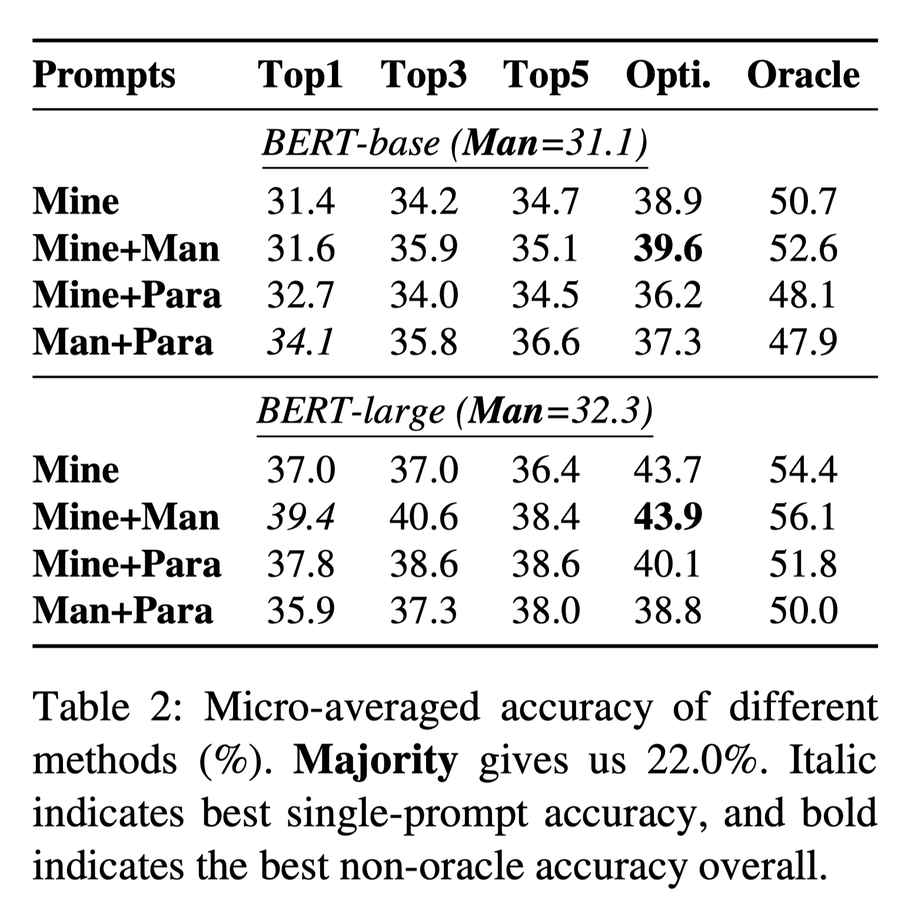
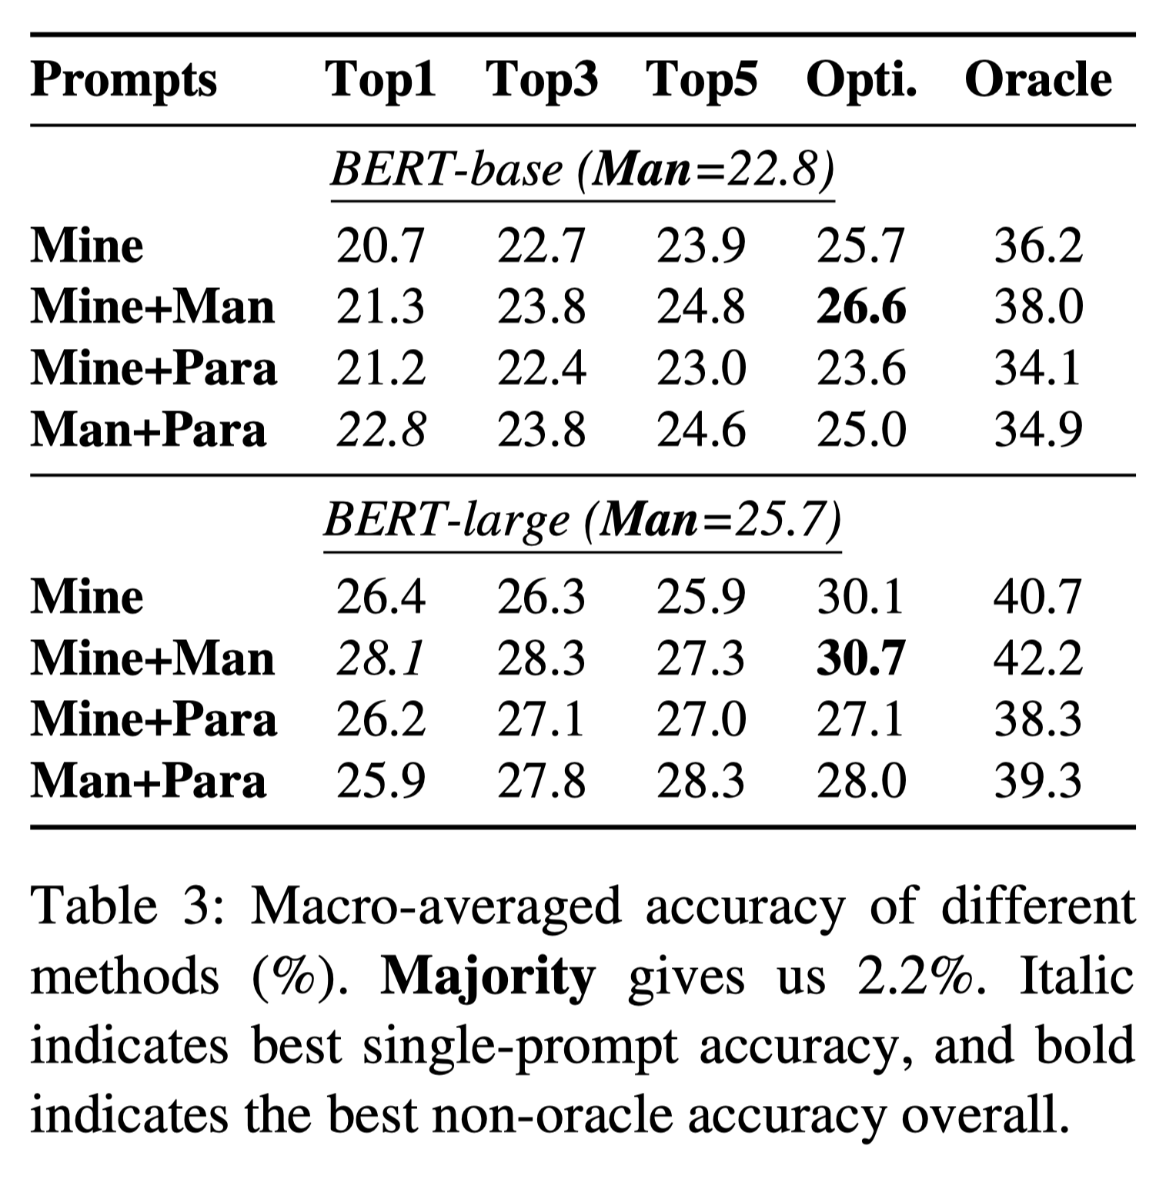
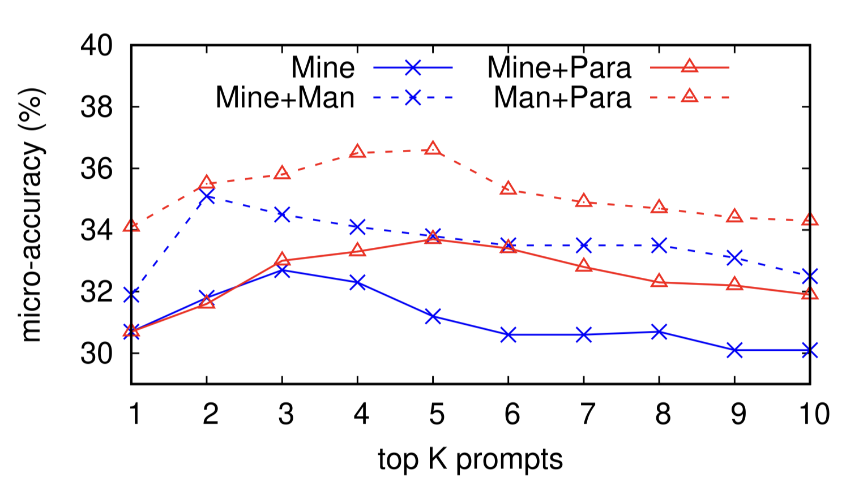
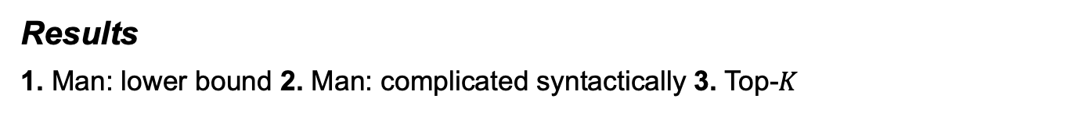
Part 3 $−$ Prompt Perturbation Selected Works
Prompt Perturbation and Robustness Evaluation
Results
1. Man: lower bound 2. Man: complicated syntactically 3. Top-$K$
upper bound
(somehow) lower bound
Credits: [1] Jiang et al., How Can We Know What Language Models Know?, In TACL’20.
[2] Man (baseline) $→$ Petroni et al., Language Models as Knowledge Bases?, In EMNLP’19.
Notes:
As you can see in the results here, generally speaking, the performance of the manually created prompts is the lower bound. Besides, as for the “Mine+Man” and “Man+Para”, the performance of mining-based methods is superior because manually written prompts are more complicated syntactically than some mined prompts. You can also check the ablation study regarding the performance of the top K prompts.

Slide 29
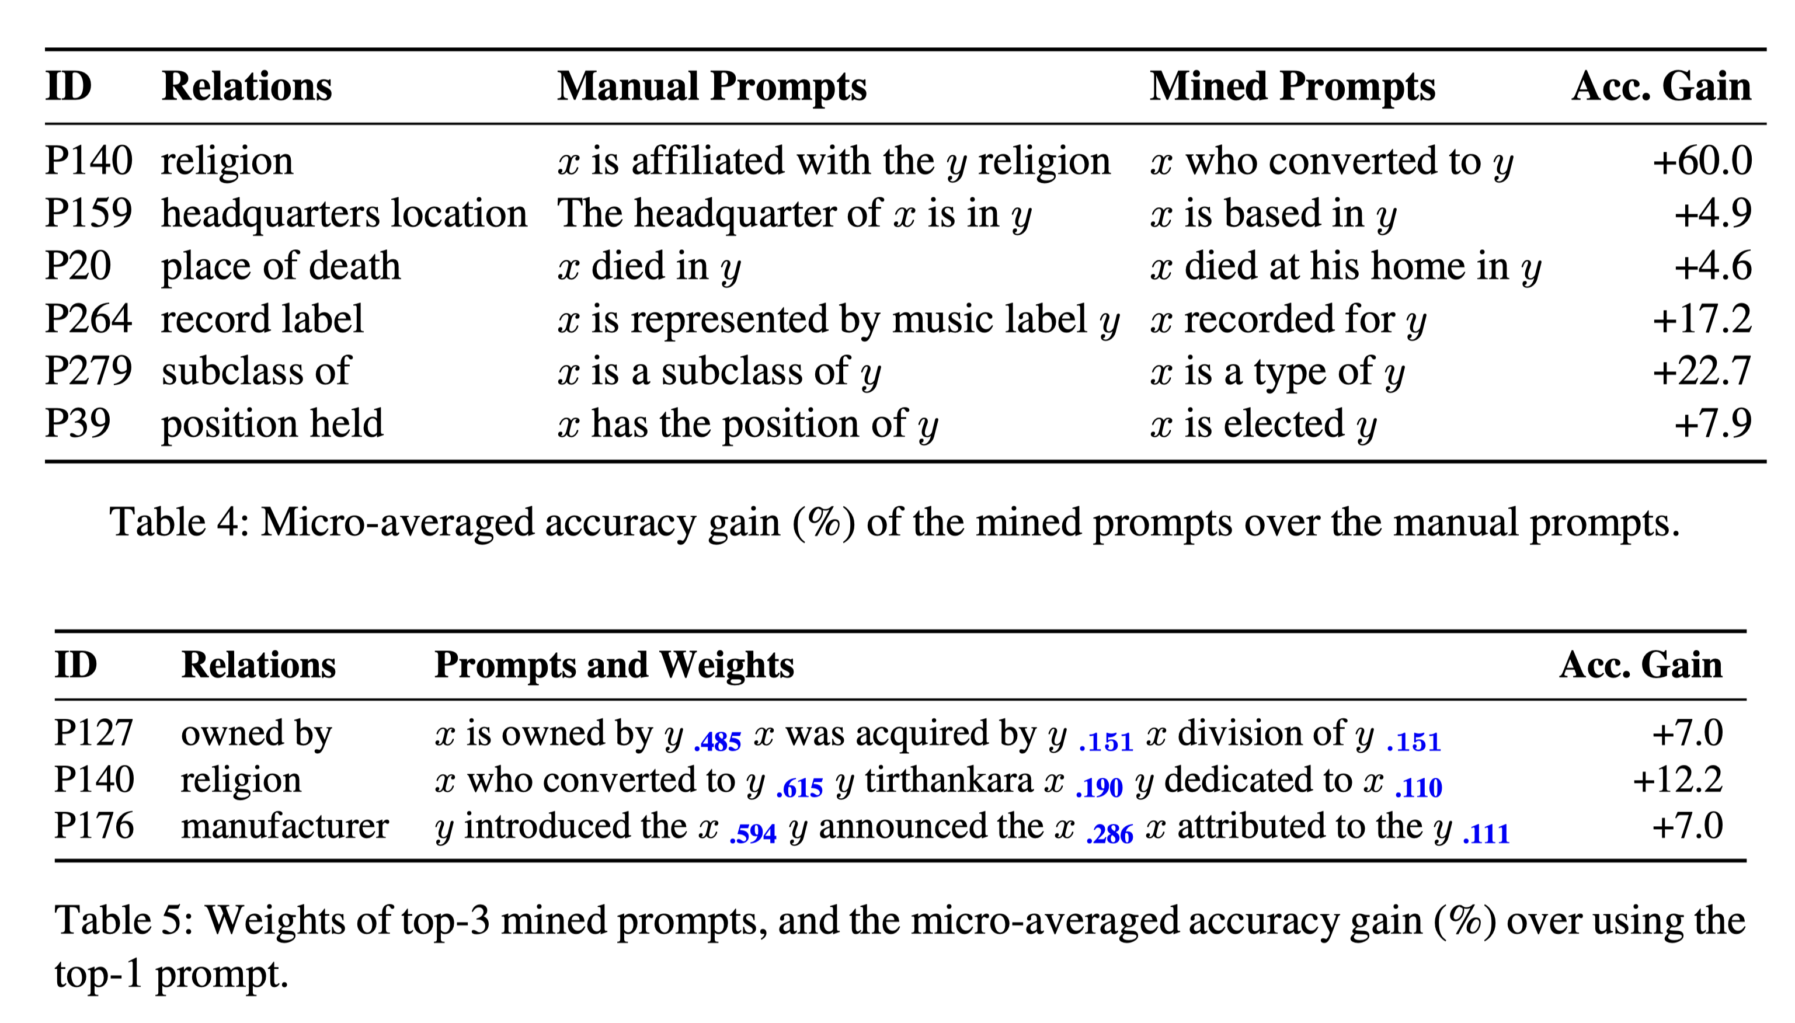
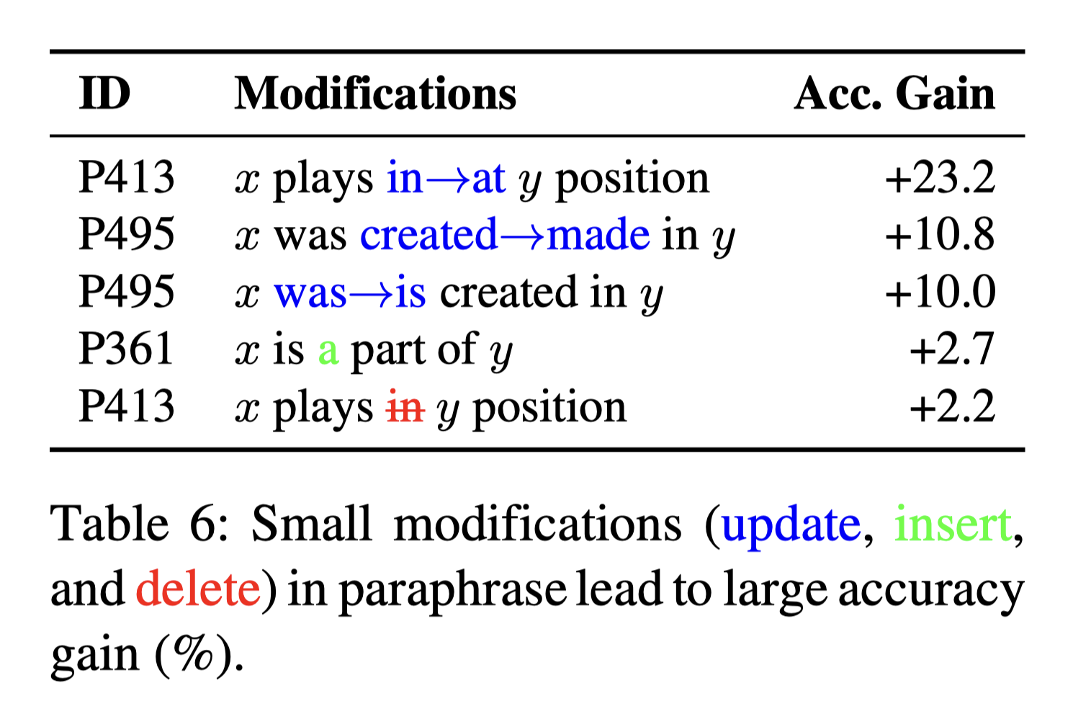
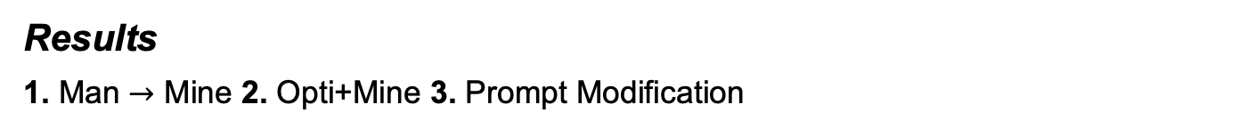
Part 3 $−$ Prompt Perturbation Selected Works
Prompt Perturbation and Robustness Evaluation
Results
1. Man $→$ Mine 2. Opti+Mine 3. Prompt Modification
Credits: [1] Jiang et al., How Can We Know What Language Models Know?, In TACL’20.
[2] Man (baseline) $→$ Petroni et al., Language Models as Knowledge Bases?, In EMNLP’19.
Notes:
From these results, u can find that the mined prompts obtain better performance than the manually written prompts. You can also see the weights given to different prompts. Lastly, in this case, you can see that the performance would be greatly different when there are small modifications. Thus, researching the effect of prompt perturbation on model robustness is critically important.

Slide 30
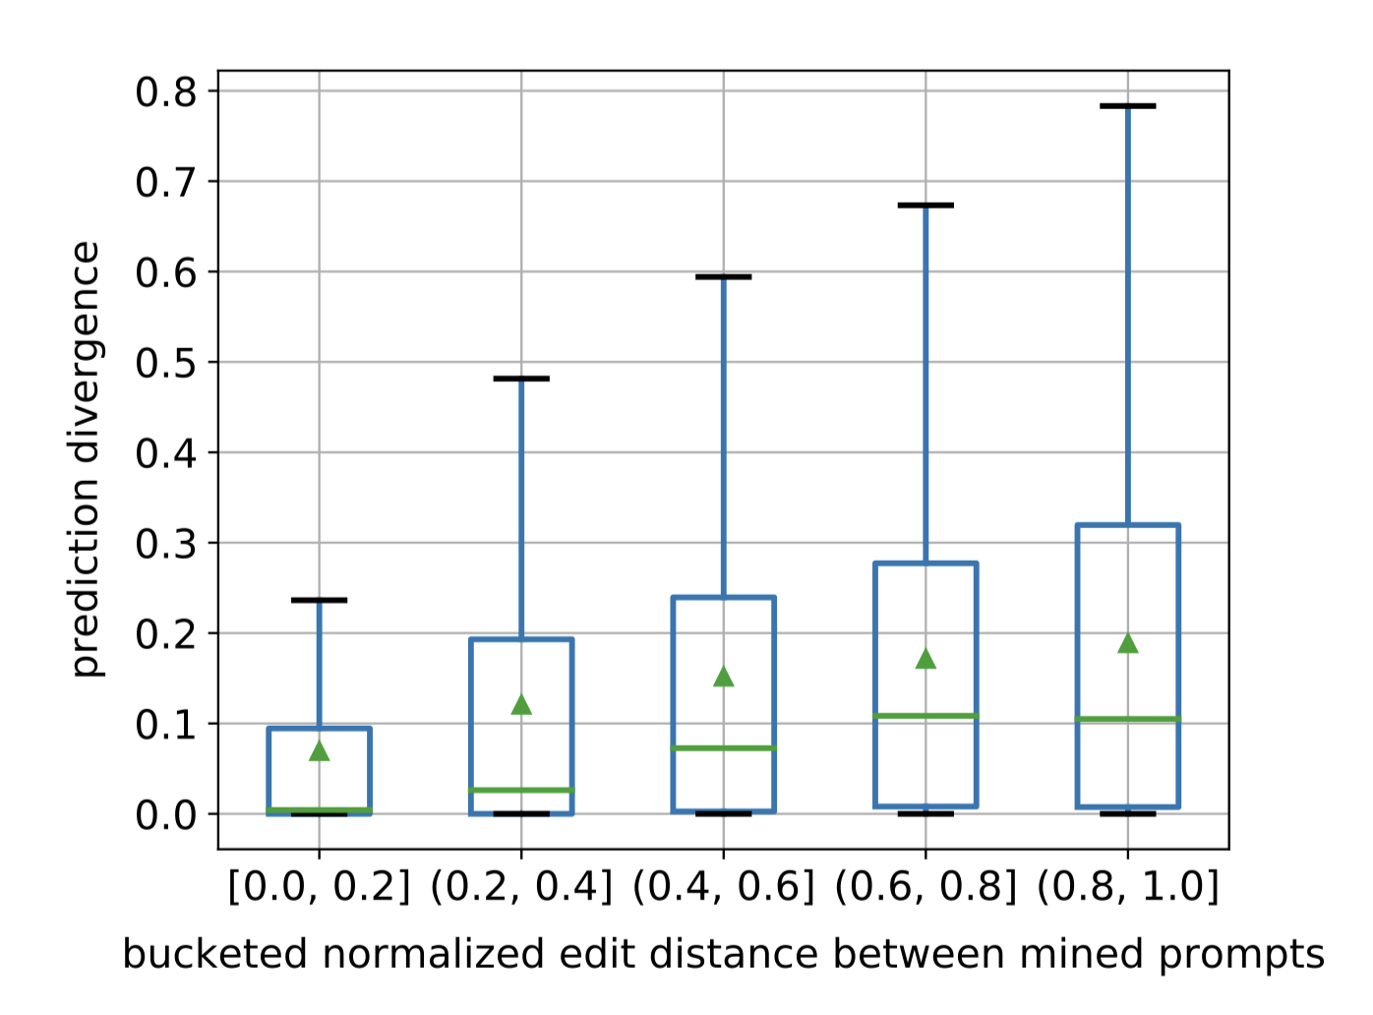
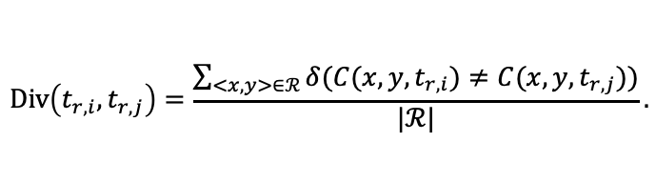
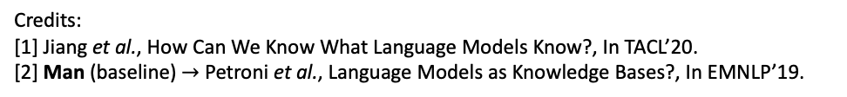
Part 3 $−$ Prompt Perturbation Selected Works
Prompt Perturbation and Robustness Evaluation
mean
median
$$Div\left(t_{r,i},t_{r,j}\right)=\frac{\sum_{<x,y>∈ℛ}{δ(C(x, y,t_{r,i})≠C(x, y,t_{r,j}))}}{|ℛ|}.$$
Credits:
[1] Jiang et al., How Can We Know What Language Models Know?, In TACL’20.
[2] Man (baseline) $→$ Petroni et al., Language Models as Knowledge Bases?, In EMNLP’19.
Notes:
Here, u can also check box chart here. It is the Correlation of edit distance between prompts and their prediction divergence. They normalize the edit distance of two prompts into [0, 1] and bucket the normalized distance into five bins with intervals of 0.2.
It indicates that as the edit distance becomes larger, the divergence increases, which confirms our intuition that very different prompts tend to cause different prediction results.

Slide 31
Part 3 $−$ Prompt Perturbation Selected Works
Prompt Perturbation and Robustness Evaluation
Limitations
Scenarios: factual knowledge extraction in the form of relation triples
Scenarios: limited by relation types
Manual Effort: Manually select a prompt from the mined set
Prediction: single-token object
Generation: Current mining-based generation is limited to Wikipedia
Technical details are not revealed and open-sourced, unfortunately.
Dataset for Mining
Wiki-ZSL (Wiki Zero-Shot Learning) dataset: 113 relations and 94,383 instances
Credits: Jiang et al., How Can We Know What Language Models Know?, In TACL’20.
Notes:
The limitations of this work are: The first one is the scenario: the background of this work is the factual knowledge extraction in the form of relation triples, and the relation types are limited. The second limitation is that they have to manually select mined prompts from the whole mined set if they don’t use this Wiki-ZSL dataset. The third limitation is that the prediction is a single-token object. The last limitation is that the generation of mining is limited to Wikipedia.

Slide 32
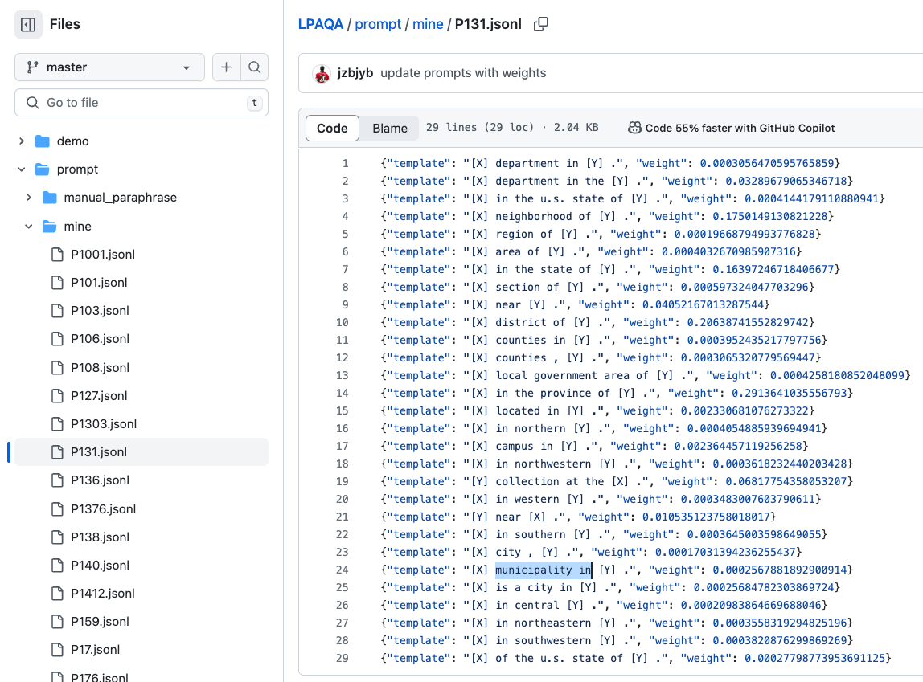
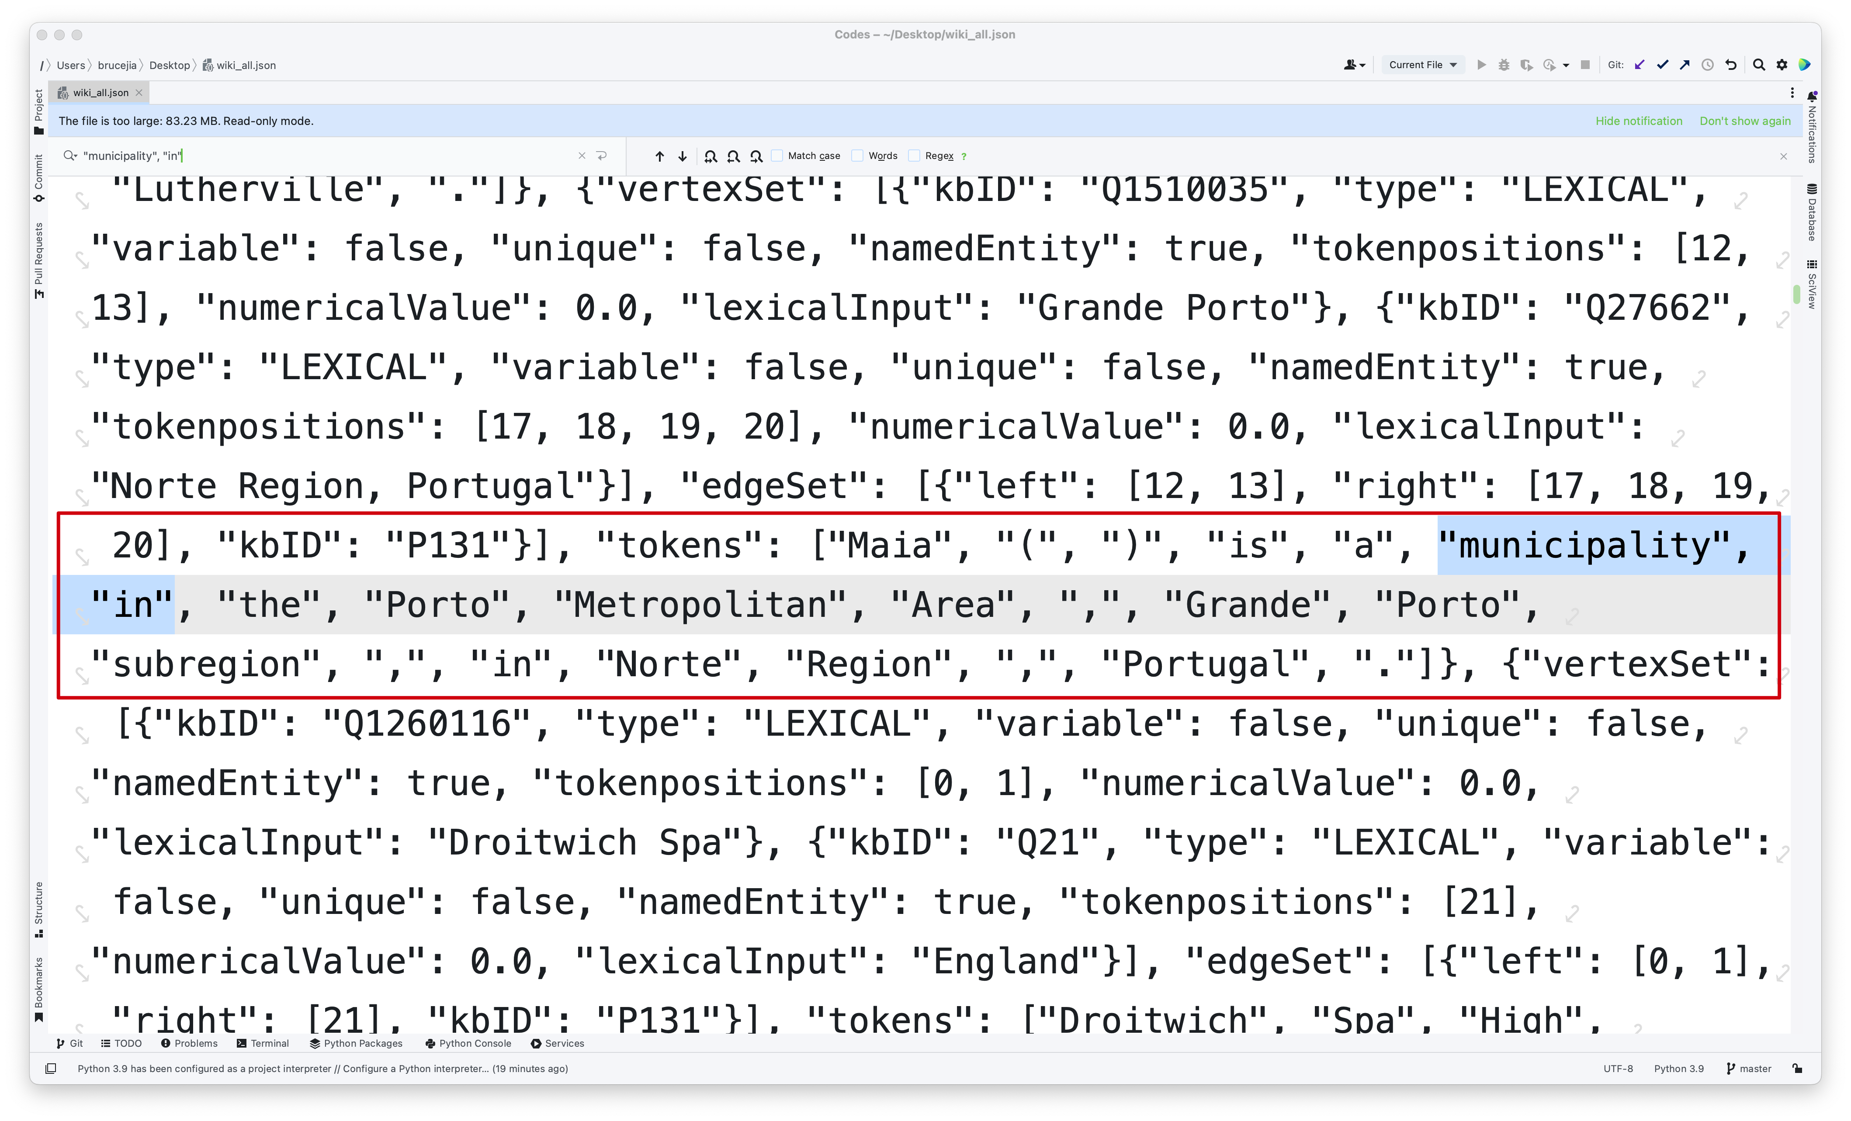
Part 3 $−$ Prompt Perturbation Selected Works
Prompt Perturbation and Robustness Evaluation
Dataset for Mining
Wiki-ZSL (Wiki Zero-Shot Learning) dataset: 113 relations and 94,383 instances
Credits: Sorokin et al., Context-Aware Representations for Knowledge Base Relation Extraction, In EMNLP’17.
Notes:
As you can see here, you used this dataset to mine prompts.

Slide 33
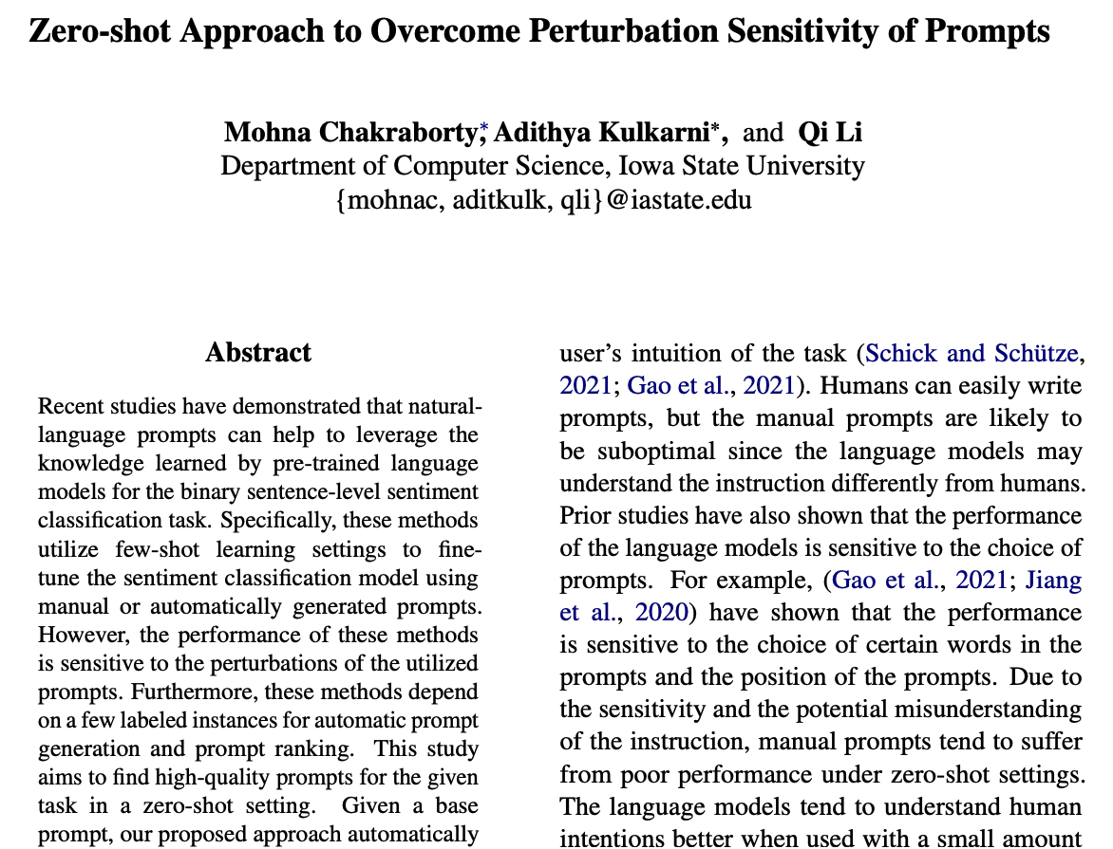
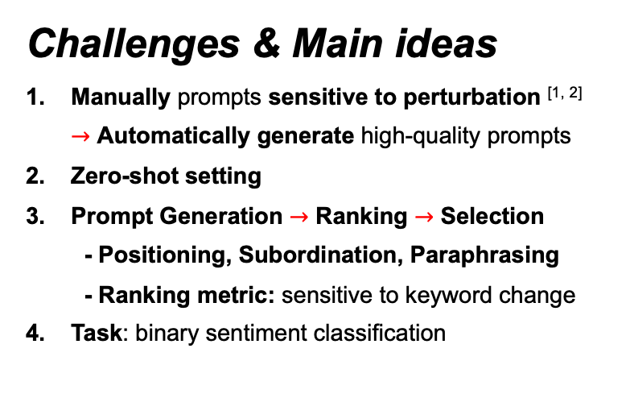
Part 3 $−$ Prompt Perturbation Selected Works
Prompt Perturbation and Robustness Evaluation
Related Work 2: Mohna Chakraborty, Adithya Kulkarni, and Qi Li. Zero-shot Approach to Overcome Perturbation Sensitivity of Prompts, Association for Computational Linguistics, 1:5698–5711, 2023.
Challenges & Main ideas
Manually prompts sensitive to perturbation ^{[1, 2]} $→$ Automatically generate high-quality prompts
Zero-shot setting
Prompt Generation $→$ Ranking $→$ Selection
- Positioning, Subordination, Paraphrasing
- Ranking metric: sensitive to keyword change
Task: binary sentiment classification
Credits: [1] Gao et al., Making Pre-trained Language Models Better Few-shot Learners, In ACL’21.
[2] Jiang et al., How Can We Know What Language Models Know?, In TACL’20.
Notes:
Here is the second related work: Positioning, Subordination, and Paraphrasing. The challenges and main ideas are as follows.
First, the manually created prompts are sensitive to perturbations, thus they wanna automatically generate high-quality prompts.
Second, previous literature has shown that due to the sensitivity and the potential misunderstanding of the instruction, manual prompts tend to suffer from poor performance under zero-shot settings, they want to automatically generate better prompts in a zero-shot setting.
Third, the general framework is the Prompt Generation $→$ Ranking $→$ Selection. For prompt generation, they used Positioning, Subordination, and Paraphrasing techniques. For prompt ranking, they propose a ranking metric which is based on prompt sensitive to keyword change. Some evidence has indicated that the performance is sensitive to the choice of certain words in the prompts and the position of the prompts.
The last one is that the task they chose was the binary sentiment classification.

Slide 34
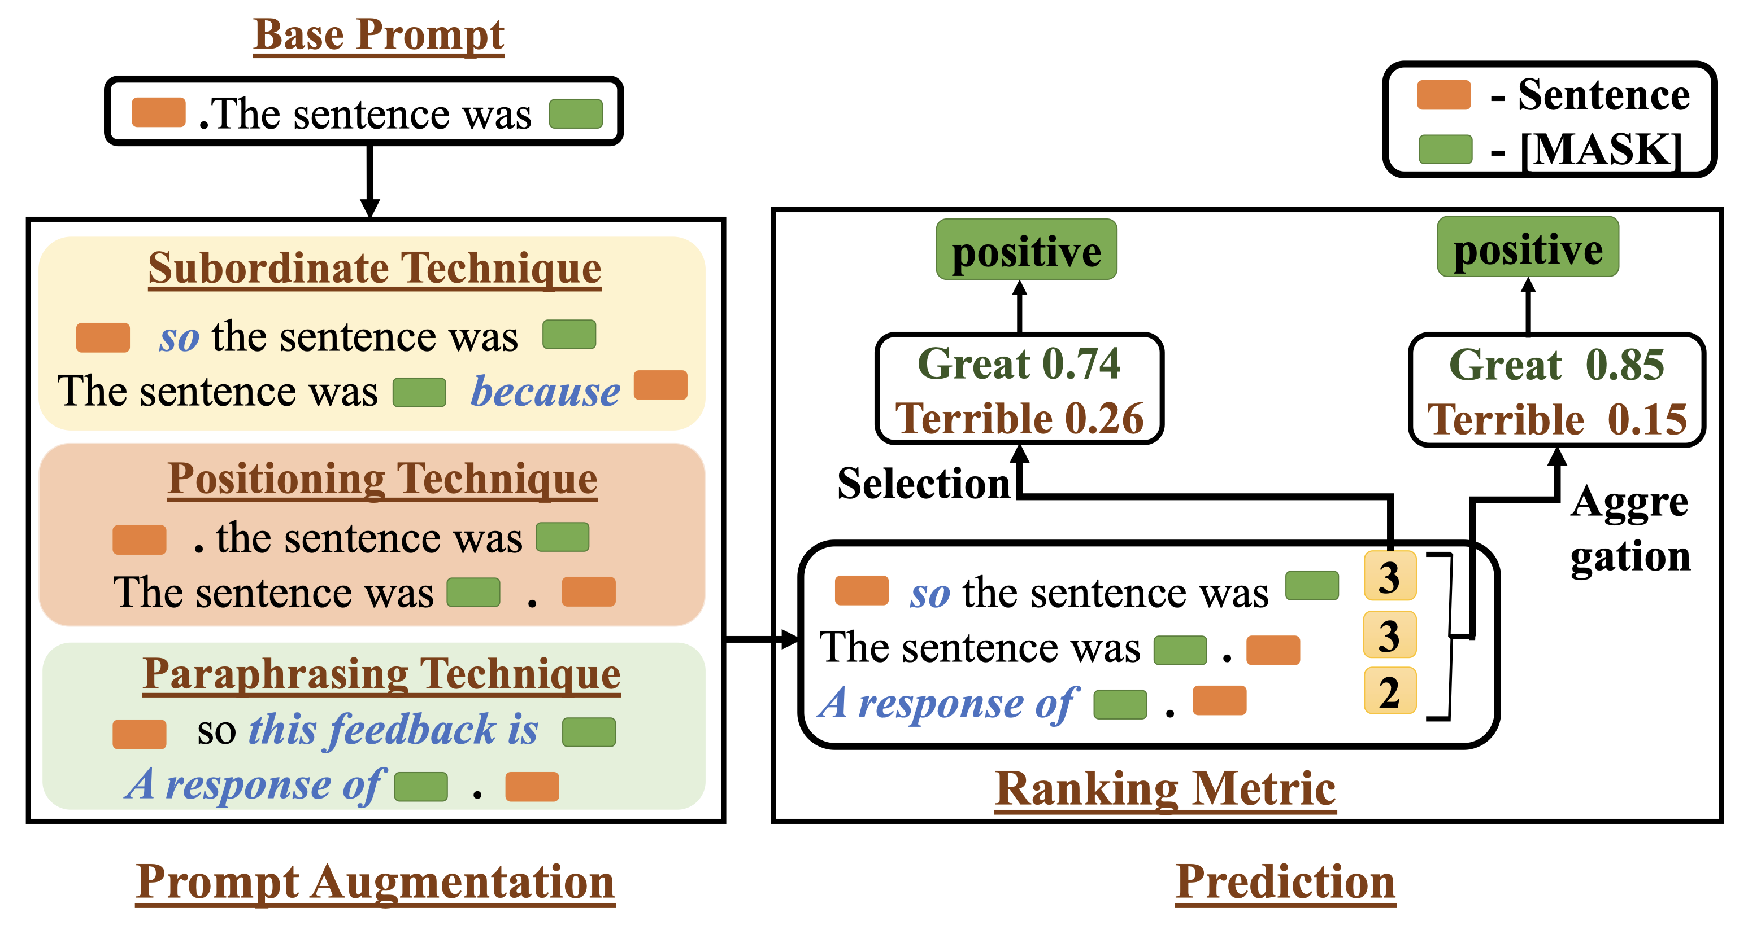
Part 3 $−$ Prompt Perturbation Selected Works
Prompt Perturbation and Robustness Evaluation
Objectives
Prompt Generation - Positioning Technique - Subordinate Technique - Paraphrasing Technique
Prompt Ranking - Zero-shot Setting
Prompt Selection - Prompt Selection and Aggregation
Credits: Chakraborty et al., Zero-shot Approach to Overcome Perturbation Sensitivity of Prompts, In ACL’23.
Notes:
The objectives of this work are Prompt Generation by Positioning, Subordinate, and Paraphrasing techniques. Then, the prompt ranking under a Zero-shot Setting. And finally the Prompt Selection and Aggregation.

Slide 35



Part 3 $−$ Prompt Perturbation Selected Works
Prompt Perturbation and Robustness Evaluation
Prompt Augmentation $−$ “[X]. The sentence was [Y]”
Positioning Technique
Places the prompt either before or after the given sentence
“The sentence was [X]. [Y]”
Subordinate Technique
Uses subordinate conjunctions like "because" and "so" to join the prompt and the sentence
“[X] so the sentence was [Y]” or “The sentence was [Y] because [X]”
Paraphrasing Technique
Synonym Replacement (SR) to the base prompt $B_{p}$
Pre-trained MLM model $ℒ$ with a randomly selected sentence [X]
Mask the replaceable tokens from the base prompt one at a time
30 candidates
Credits: Chakraborty et al., Zero-shot Approach to Overcome Perturbation Sensitivity of Prompts, In ACL’23.
Notes:
Here, I’ll present the prompt generation, or the authors called Prompt Augmentation, in detail. The base prompt is “[X]. The sentence was [Y]”
The Positioning Technique is to place the prompt either before or after the given sentence. For example, “The sentence was [X]. [Y]”
The Subordinate Technique is to use subordinate conjunctions like “because” and “so” to join the prompt and the sentence. For example, “[X] so the sentence was [Y]” or “The sentence was [Y] because [X]”
The paraphrasing technique is to use the Synonym Replacement (SR) to the base prompt $B_{p}$. They applied another Pre-trained MLM model $ℒ$ to predict possible word change given a randomly selected sentence [X] from the corpus. They applied this method by masking the replaceable tokens from the base prompt one at a time. Here, they used 30 candidates for each word.

Slide 36







Part 3 $−$ Prompt Perturbation Selected Works
Prompt Perturbation and Robustness Evaluation
Prompt Ranking $−$ under zero-shot setting
Zero-shot Setting
High-quality prompt $P$ (with number $S_{W}$) should be more sensitive to changing certain keywords $𝒱$
Key token $𝒱$ flips $⇒$ Predicted label $𝒴$ flips
Mapping token $𝒱$ [“great” $→$ “positive”]
Use Wordnet ^{[2]} to obtain synonyms
Zero-one scoring function
$$O\left(𝒱\right)=O\left(𝒱_{same}\right)$$
$Z=12$ times
$$λ_{s_{in}}=\left\{\begin{aligned}1, if O\left(𝒱\right)=O\left(𝒱_{same}\right) or O\left(𝒱\right)≠O\left(𝒱_{flip}\right); \\ 0, otherwise.\end{aligned}\right.$$
$$O\left(𝒱\right)≠O\left(𝒱_{flip}\right)$$
$$Score\left(P\right)=\sum_{i=1}^{|S_{W}|}{\sum_{j=1}^{|Z|}{λ_{s_{ij}}}}.$$
Credits:
[1] Chakraborty et al., Zero-shot Approach to Overcome Perturbation Sensitivity of Prompts, In ACL’23.
[2] Miller et al., WordNet: A Lexical Database for English, In Communications of the ACM’1995.
Notes:
The next step is the prompt ranking under a zero-shot setting.
The assumption is that high-quality prompt $P$ (with number $S_{W}$) should be more sensitive to changing certain keywords $𝒱$ and Key token $𝒱$ flips shouldlead to the Predicted label $𝒴$ flips. The keyword here is called a Mapping token. In this work, they used Wordnet to obtain synonyms. And then, by measuring the sensitivity of label change by flipping the mapping token, we can obtain a score of how good this prompt is.

Slide 37


Part 3 $−$ Prompt Perturbation Selected Works
Prompt Perturbation and Robustness Evaluation
Prompt Selection and Aggregation
Prompt Selection
Given the sentence and prompt, predict $\left[MASK\right]$ and select the highest probability $p\left(y | s_{in}\right)=p\left(\left[MASK\right] \right| s_{in},P).$
Prompt Aggregation
Aggregate top-$k$ ranked prompts
$$Score\left(P_{i}\right)=\sum_{j=1}^{|Z|}{λ_{s_{j}}},$$
$$p\left(y\right)=\frac{\sum_{i=1}^{k}{Score\left(P_{i}\right)×p_{i}(y)}}{\sum_{i=1}^{k}{Score\left(P_{i}\right)}}.$$
Credits: Chakraborty et al., Zero-shot Approach to Overcome Perturbation Sensitivity of Prompts, In ACL’23.
Notes:
The final module is the Prompt Selection and Aggregation. For the prompt selection, they selected the highest probability of output, given the sentence and prompt.
Then, they also used weighted aggregation to give a weight to each output prediction.

Slide 38


Part 3 $−$ Prompt Perturbation Selected Works
Prompt Perturbation and Robustness Evaluation
Data $−$ binary sentence-level sentiment classification datasets
Stanford Sentiment Treebank v2 (SST-2) ^{[2]}: predicting Sentiment from longer Movie Reviews
MR Movie Reviews (MR) ^{[3]}: overall sentiment polarity (positive or negative) or subjective rating (two and a half stars) and sentences with respect to their subjectivity status (subjective or objective) or polarity.
Customer Review (CR) ^{[4]}: customer review​ ​ of​ ​ products
Models
BERT-base and BERT-large models ^{[5]}
Credits:
[1] Chakraborty et al., Zero-shot Approach to Overcome Perturbation Sensitivity of Prompts, In ACL’23.
[2] Socher et al., Recursive Deep Models for Semantic Compositionality Over a Sentiment Treebank, In EMNLP’13.
[3] Pang et al., Thumbs up? sentiment classification using machine learning techniques, In EMNLP’02.
[4] Hu et al., Mining and summarizing customer reviews, In KDD’04.
[5] Devlin et al., BERT: Pre-training of Deep Bidirectional Transformers for Language Understanding, In NAACL’19.
Notes:
They used the Stanford Sentiment Treebank v2, the SST-2 dataset,
the MR Movie Reviews, the MR dataset,
and the Customer Review, the CR dataset.
In this work, they used BERT-base and BERT-large models.

Slide 39


Part 3 $−$ Prompt Perturbation Selected Works
Prompt Perturbation and Robustness Evaluation
Results
1. ⋆ base prompt 2. aggregation strategy 3. LM-BFF
manual + few-shot
fine-tuning
pretraining hard prompts
by adding soft prompts
“<sentence>.
It was [MASK]”
“<sentence>.
The sentence
was [MASK]”
Credits: Chakraborty et al., Zero-shot Approach to Overcome Perturbation Sensitivity of Prompts, In ACL’23.
Notes:
Here are some experimental results comparing automatic-based and manual-based LM-BFF, UPT, and PPT models.

Slide 40


Part 3 $−$ Prompt Perturbation Selected Works
Prompt Perturbation and Robustness Evaluation
Results
Top-ranked prompts
Credits: Chakraborty et al., Zero-shot Approach to Overcome Perturbation Sensitivity of Prompts, In ACL’23.
Notes:
As you can also see here, there are top-weighted and top-ranked prompts.

Slide 41

Part 3 $−$ Prompt Perturbation Selected Works
Prompt Perturbation and Robustness Evaluation
Limitations
Scenarios: limited area of output, e.g., positive or negative
Subordinate: because-so causality
Prediction: single-token objects
Ranking: Need mapping token
Credits: Chakraborty et al., Zero-shot Approach to Overcome Perturbation Sensitivity of Prompts, In ACL’23.
Notes:
The limitations of this work are as follows

Slide 42
Part 3 $−$ Prompt Perturbation Selected Works
Prompt Perturbation and Robustness Evaluation
Summary
Year | Author | Institution | Title | Scenario | Metrics | Method | Model | Result
2020 TACL | Zhengbao Jiang, Frank F. Xu, Jun Araki, and Graham Neubig | CMU, Bosch Research | How Can We Know What Language Models Know? | Relation triples | Micro-averaged Accuracy; Macro-averaged Accuracy | Mining Paraphrasing | BERT-base; BERT-large | Mine+Man: 43.9% (Micro) and 30.7% (Macro) on LAMA T-REx
2023 ACL | Mohna Chakraborty, Adithya Kulkarni, and Qi Li | Iowa State University | Zero-shot Approach to Overcome Perturbation Sensitivity of Prompts | Limited area of output (positive or negative) | Accuracy; Macro F1 Score | Subordinate Positioning Paraphrasing | BERT-base; BERT-large | Accuracy: 77.11% (SST-2) 72.96% (MR) 81.45% (CR)
2023 EACL | Yoichi Ishibashi, Danushka Bollegala, et al. | Nara Institute of Science and Technology, ULiverpool | Evaluating the Robustness of Discrete Prompts | Evaluation of prompt perturbation | Accuracy; Rate of Degradation (RoD) | Token Reordering Deletion; Adversarial Perturbations | AutoPrompt; Manually-written Prompts (MP) | -
Notes:
Here is a summary of my selected readings, including the last one I didn’t present here, but also useful to our project.

Slide 43


Part 4 $−$ Robustness Problem Formulation
Prompt Perturbation and Robustness Evaluation
Foundational Robustness:
Evaluation and enhancement of (and sometimes certifiable) model correctness against natural and adversarial data shifts $→$ A foundation of trustworthy AI
Robustness Category:
Adversarial Robustness (worst-case performance) $x^{′}$ similar to $x$, and $δ$ is small perturbations. Ideally, $f_{θ}\left(x^{′}=x+δ\right)=f_{θ}\left(x\right).$
Out-of-distribution (OOD) generalization (domain shifts) $x\sim D, x^{′}\sim D^{′}$, where $D^{′}$ is the shifted version of $D$. Ideally, $f_{θ}\left(x^{′}\right)=f_{θ}\left(x\right).$
Out-of-distribution detection (unknowns) $x\sim D, x^{′}\sim D^{′}$, where $D^{′}$ is a dissimilar or new domain compared with $D$. Ideally, $f_{θ}\left(x^{′}\right)=“Unknown”.$
Credits: Pin-Yu Chen and Sijia Liu, Foundational Robustness of Foundation Models Tutorial, In NeurIPS’22.

Slide 44

Part 4 $−$ Robustness Problem Formulation
Prompt Perturbation and Robustness Evaluation
Empirical Adversarial Robustness: The model $f(∙)$ is robust by optimizing the empirical adversarial risk: $\min_{θ}{𝔼_{(x, y)}[\max_{δ∈∆}{ℒ\left({f_{θ}(x}^{′}=x+δ\right),y)}]\text{.} }$
Robust optimization (min-max) formulation of adversarial learning
$∆$: a neighborhood (allowable subset of perturbations) of $x$
$δ∈∆=\{δ: {\left\|δ\right\|}_{∞}=\max_{i}\left|δ_{i}\right|≤ε\}$, and $x^{′}=x+δ$ is the adversarial example
$ℒ$: negative cross entropy of $f_{θ}(x)$ and $y$
Provide robustness within an $ε$-bounded threat model for an $ℓ_{p}$ or $ℓ_{∞}$ norm
Credits: Pin-Yu Chen and Sijia Liu, Foundational Robustness of Foundation Models Tutorial, In NeurIPS’22.
Notes:
Adversarial training: we iteratively compute adversarial examples, and then update the classifier based not upon the original data points, but upon these adversarial examples

Slide 45


Part 4 $−$ Robustness Problem Formulation
Prompt Perturbation and Robustness Evaluation
Certified Adversarial Robustness: The model $f(∙)$ is certified robust if it satisfies the following condition for $∀x$:
$x=[x_{1},x_{2},…,x_{L}]$: input to the LLM $f(∙)$
$\left\|x^{′}\right.−{\left.x\right\|}_{0}$: Hamming Distance
$𝕀(∙)$: Indicator Function
$d$: perturbation scale; $dL$: neighborhood $R$ (certified range)
Problem: (1) Same length sequence (2) Never consider semantics change
$$f\left(x^{′}\right)=f\left(x\right)=y,$$
$$\left\|x^{′}\right.−{\left.x\right\|}_{0}=\sum_{i=1}^{L}{𝕀(x_{i}^{′}≠x_{i})}≤dL.$$
Credits: Zhang et al., Certified Robustness for Large Language Models with Self-Denoising, In arXiv’23.
Notes:
A certified robust LLM is expected to generate the correct output y, given at max d percentage word perturbation on the input.

Slide 46



Part 5 $−$ Robustness Evaluation
Prompt Perturbation and Robustness Evaluation
Rate of Degradation (RoD) ^{[1, 2]} / MultiModal Impact score (MMI) ^{[3]}:
The decrease in accuracy of the target task due to the perturbations added to the prompt.
A smaller RoD indicates a more robust model against perturbations
where $x^{∗}$ is the perturbed version of the original prompt $x$, and $avg{acc}_{x}$ and $avg{acc}_{x^{∗}}$ are the averaged accuracies over $M$ prompts
$$RoD=\frac{avg{acc}_{x}−avg{acc}_{x^{∗}}}{avg{acc}_{x}}=1−\frac{avg{acc}_{x^{∗}}}{avg{acc}_{x}},$$
Credits:
[1] Meyers et al., Signal Processing on PV Time-series Data: Robust Degradation Analysis Without Physical Models, In IEEE J-PV’19.
[2] Ishibashi et al., Evaluating the Robustness of Discrete Prompts, In EACL’23.
[3] Qiu et al., Are Multimodal Models Robust to Image and Text Perturbations?, In arXiv’23.

Slide 47
Thank you very much for your attention!

